Slide 1

Diphtheria Epi Update
23 April 2026
Notes:
Remember to Acknowledge Country where you are presenting

Slide 2
Diphtheria History in Australia
4 localized diphtheria clusters in different geographical areas of North QLD. Peak notifications 25/year
Cases continue to increase. Respiratory Cases. New cases in WA
15,000 cases per year. Widespread vaccine introduced
Increase in diphtheria notifications in NT
1932
2020-2022
Oct 2025
March 2026
1964-2020
2022-2025
Feb 2026
April 2026
Sporadic cases only
Average of 5.5 cases reported per year
Marked increase in cases in NT, primarily cutaneous
Cases detected in SA

Slide 3
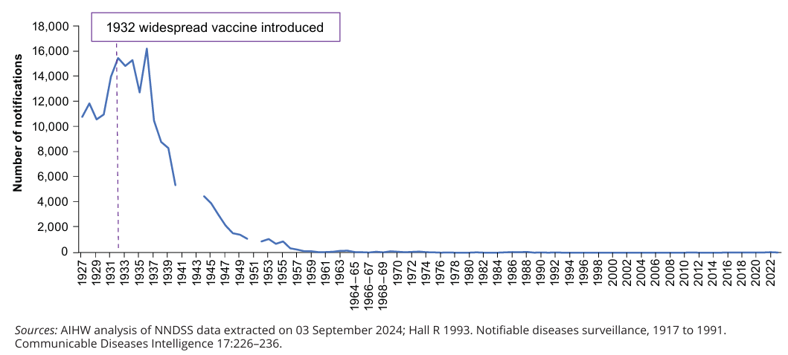

Slide 4
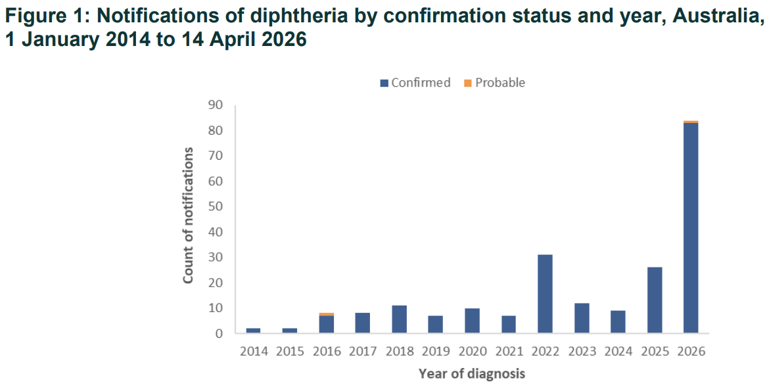

Slide 5
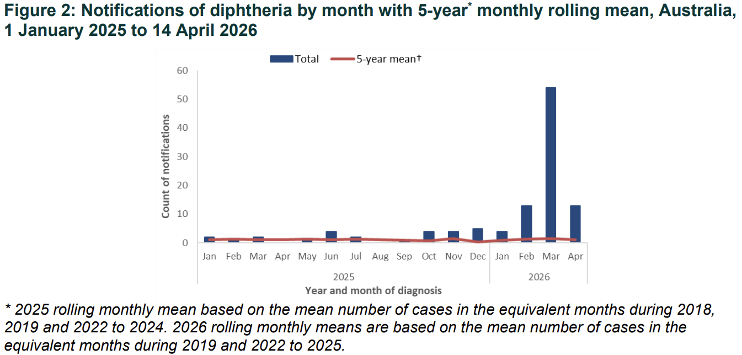

Slide 6
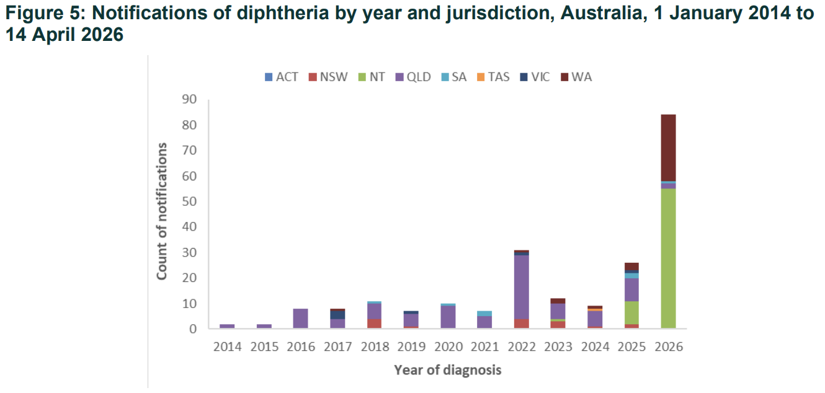

Slide 7
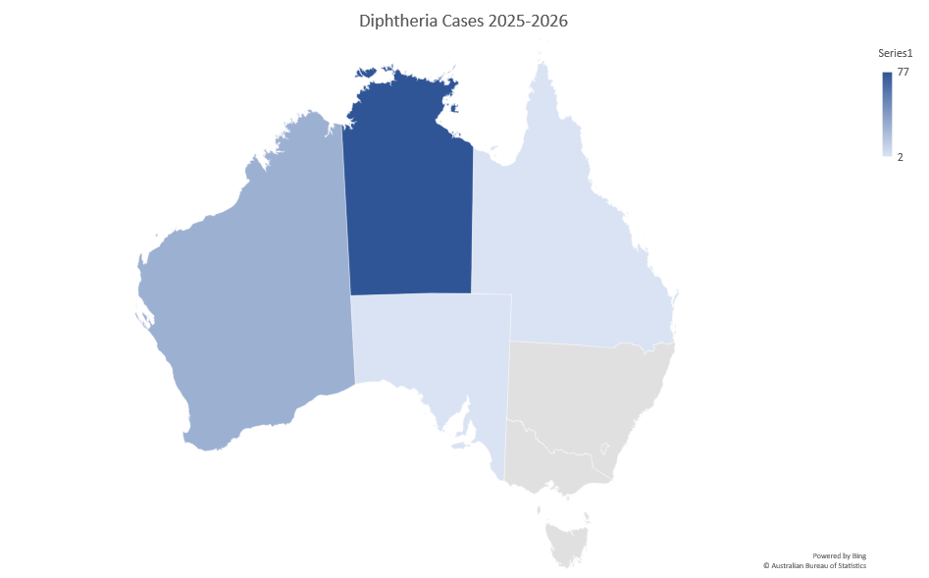

Slide 8
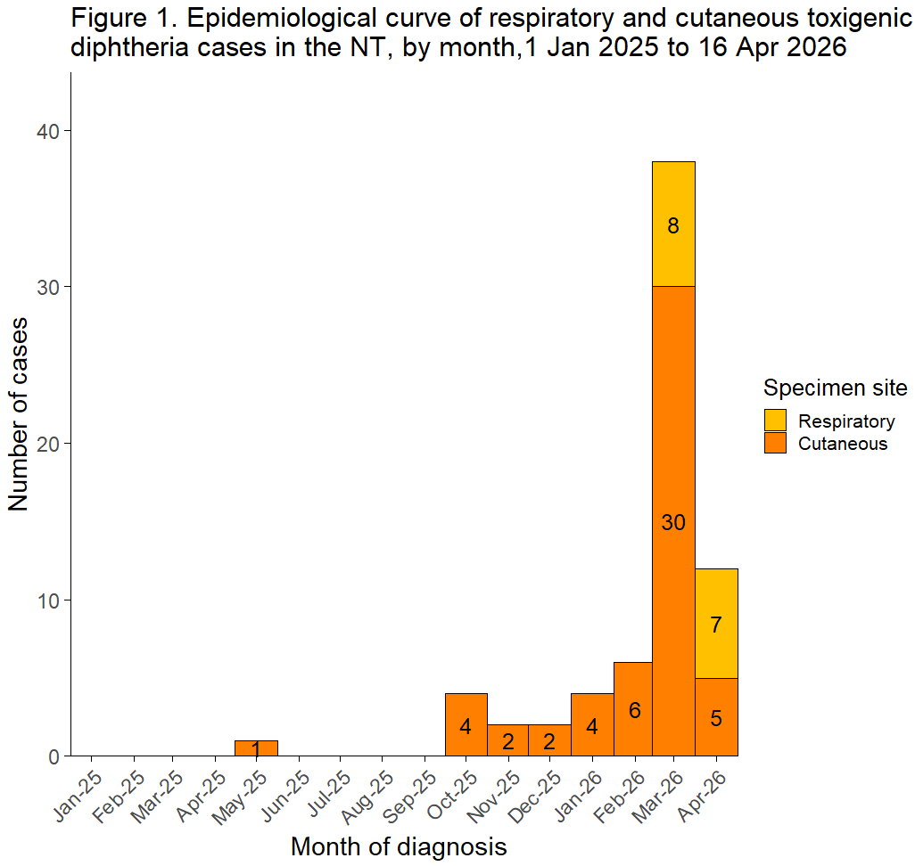

Slide 9
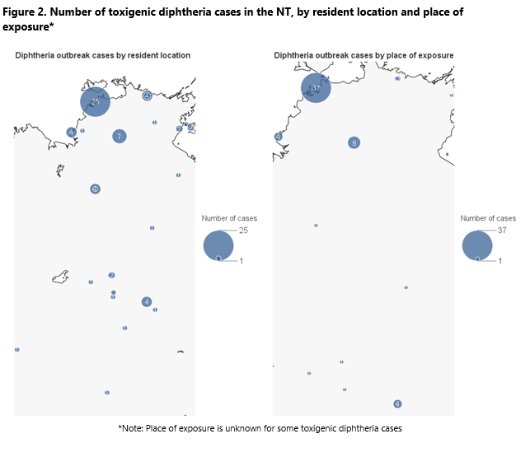

Slide 10
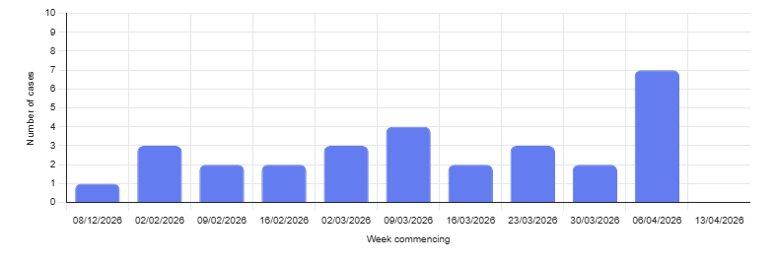
Epi curve in WA from 8/12/26 – 12/4/26

Slide 11
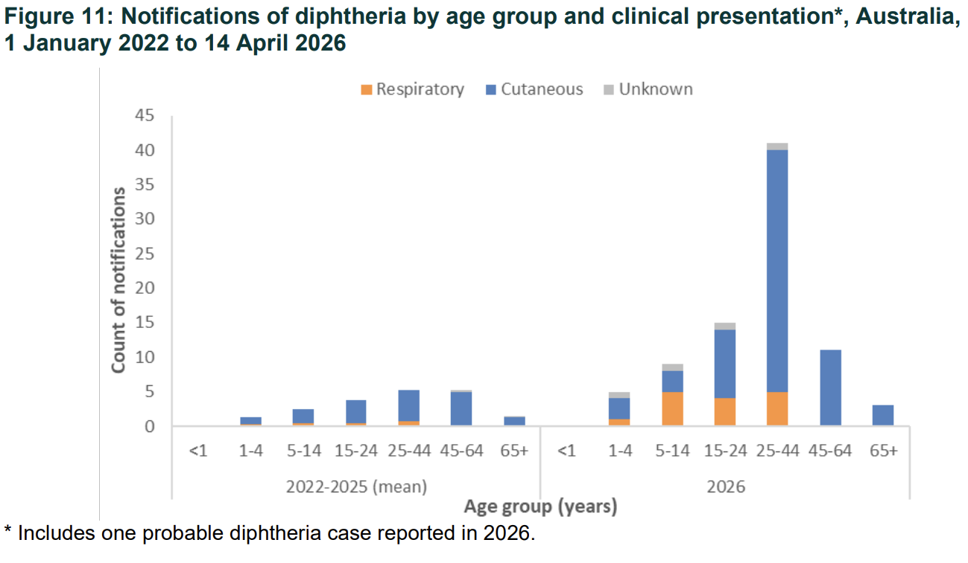

Slide 12
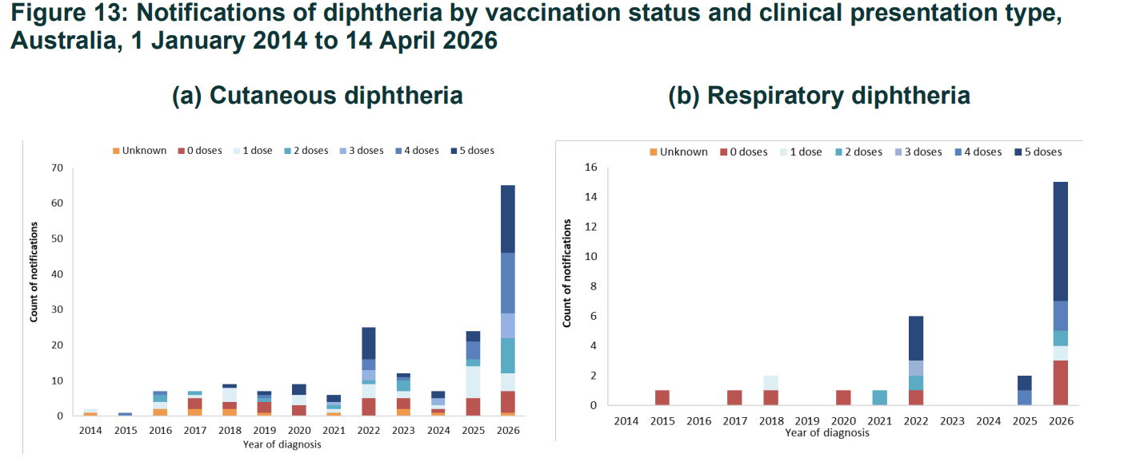

Slide 13
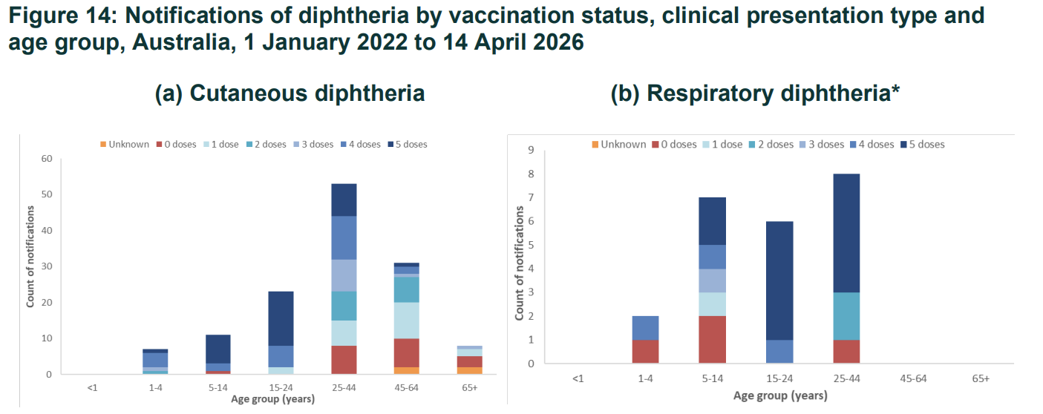

Slide 14
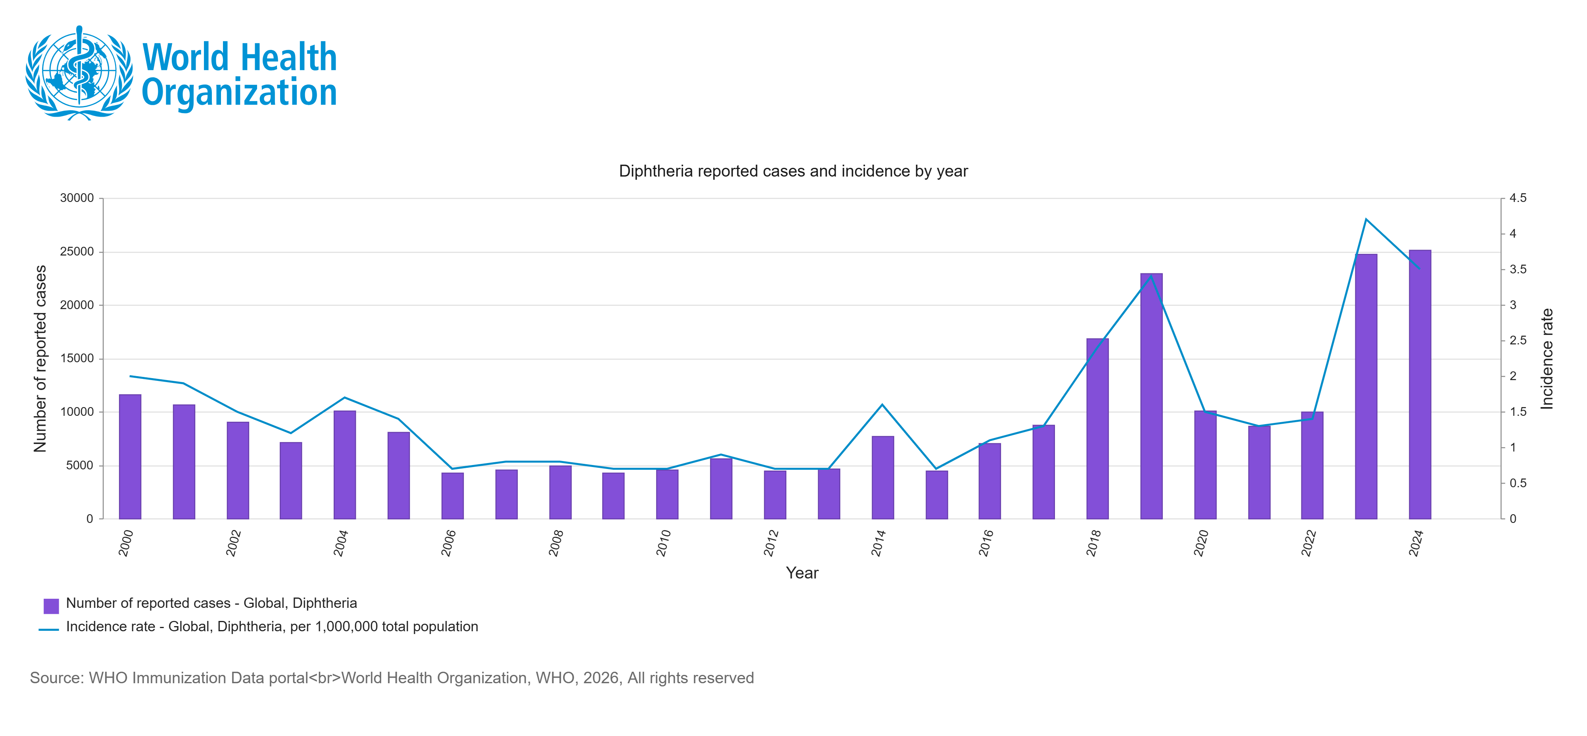

Slide 15
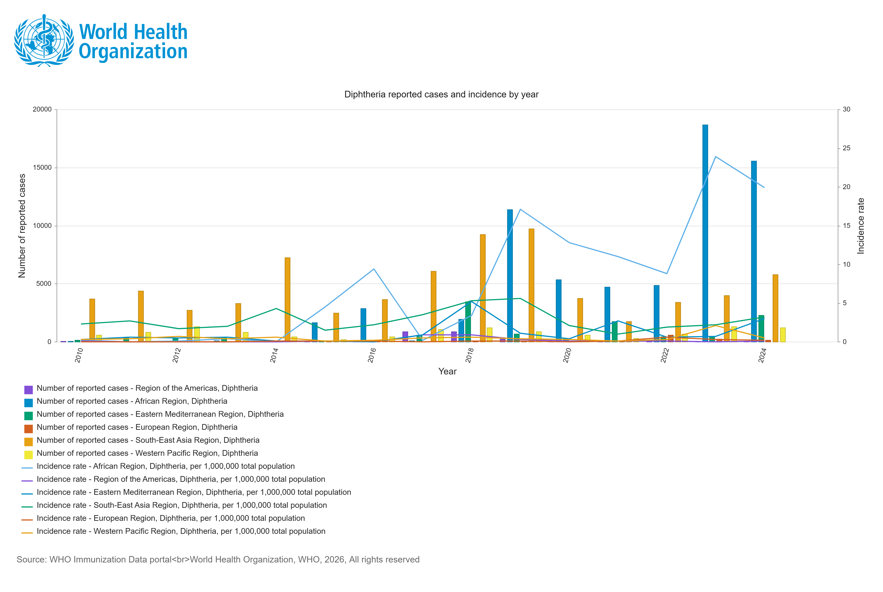

Slide 16
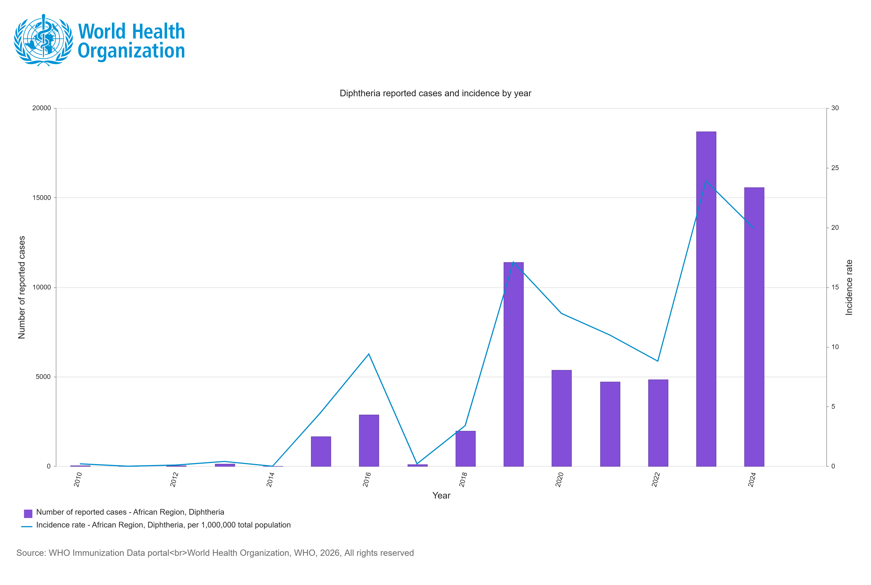

Slide 17
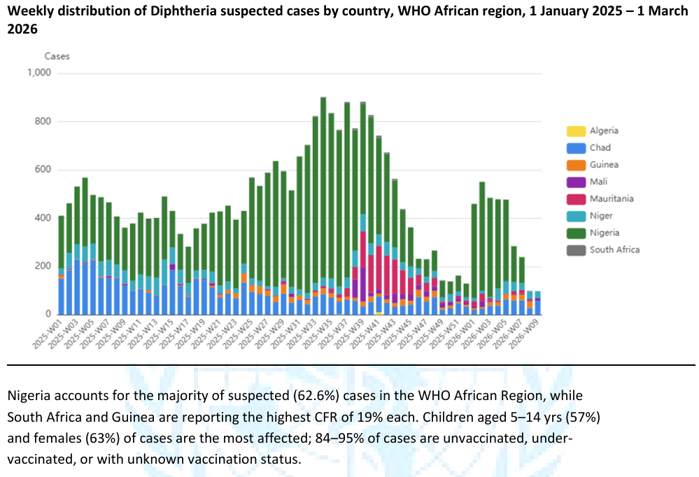
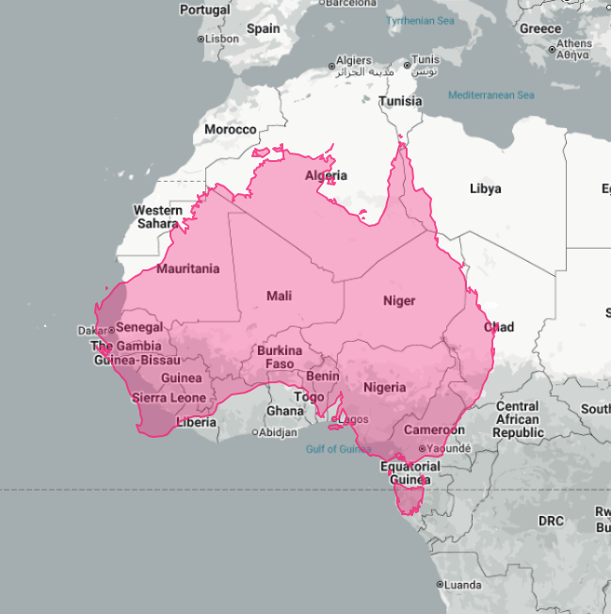

Slide 18
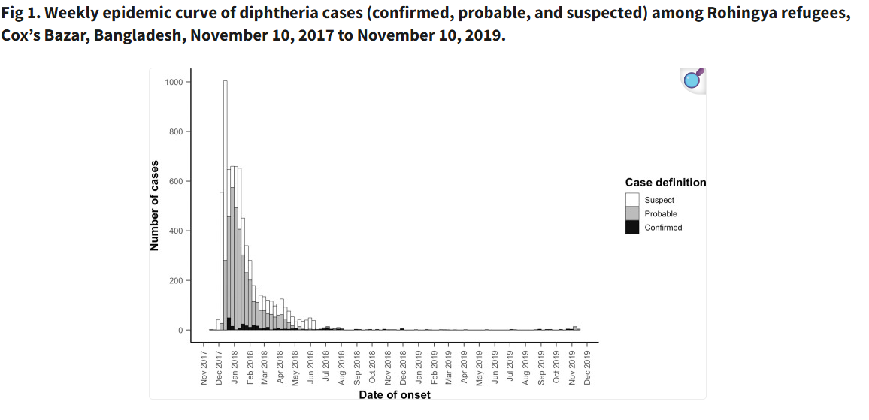

Slide 19
