Slide 1


Diphtheria outbreak 23/4/26
Title of Presentation /

Slide 2

Systematic review findings on diphtheria outbreak control
Vaccination does not prevent colonisation with the bacteria, but the estimated reduction in transmission is 60% (vaccination effective at reducing risk of toxin mediated disease)
Estimated to be able to stop outbreaks in 27% of cases
Transmission can be interrupted by finding cases soon after onset and treating with antibiotics (azithromycin)
Contact tracing with use of antibiotics is also supportive of control (household like contacts) as is isolation of cases
Truelove et al. Clinical Infectious Diseases, 2020:71 Clinical and Epidemiological Aspects of Diphtheria: A Systematic Review and Pooled Analysis. - Abstract - Europe PMC
Title of Presentation /

Slide 3
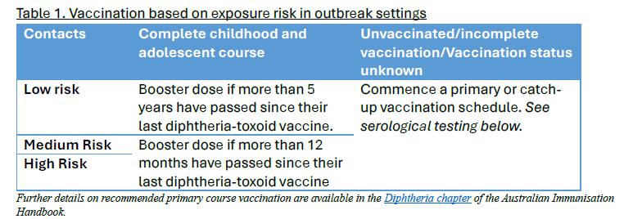
Diphtheria vaccines
Prevent symptomatic toxin-mediated disease but do not consistently prevent carriage or transmission
Primary (NIP): 2, 4, 6, 18m and 4 years, booster 11-13y
Coverage in children is high (95% at 60 m), but low for adults (30% up to date)
Adult recommendations (not funded)
  booster if over 50 and no booster in the last 10 years), same recommendation at age 65
ATAGI Interim advice 17 April 2026 FOR OUTBREAK SETTINGS
Everyone should be UTD with immunisations but for adults (non-pregnant) this is not funded
Healthcare workers or travellers to an outbreak setting should have a booster if >5 years since last vaccine
DtPa or dTPa preferred over ADT for adults
Title of Presentation /

Slide 4
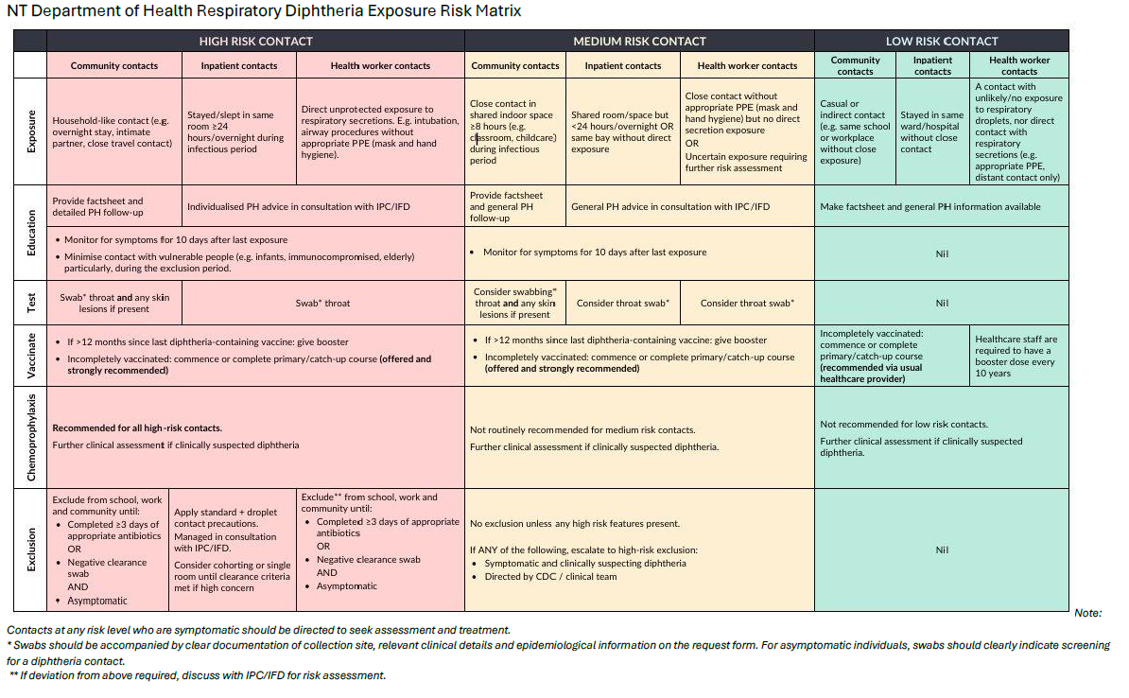
Notes:
Depending on your policy, pertussis is a mandatory vaccine for HCW every 10 years in SA Health

Slide 5
Vaccination work underway
Training for independent AHP vaccination
  AHCSA course for AHPs (and if needed, RNs) 11-15 May in Adelaide
  Support back in clinic to supervise vaccination until competency achieved
  Governance support to vaccinate independently under the Vaccine Code
Vaccine hesitancy campaign
Vaccine hesitancy training for staff
Resources – advice from members on what would be helpful

Slide 6
For awareness, treatment guidelines
ACDC has developed an interim guideline (attached to email)
NT has a treatment guideline Clinical management of diphtheria for primary care in the Northern Territory: Interim guideline
CDNA is preparing guidance on Public Health management
ATAGI will provide further guidance on vaccination
No SA specific guidance at this stage but development has commenced, PH Alert suggests:
  Test all suspected cases, azithromycin for cases, cover wounds, contact tracing via CDCB (e.g. isolation, testing, antibiotic prophylaxis, vaccination)
DAT

Slide 7
Focus on
Testing and treating cases as quickly as possible – contact and droplet precautions, social distancing in clinics for people who are sick with sore throat
Notification of CDCB if positive
Ensuring kids UTD with vaccinations and on time
Consider more staff being trained in May course in vaccination 11-15th and any governance update required
Keeping updated through weekly meeting on new developments.

