Slide 1


WOMEN’S DV COURT ASSISTANCE SERVICE

Slide 2
Background
The Women’s Domestic Violence Court Assistance Service (WDVCAS) came about as part of the South Australian Government’s ‘Taking a Stand’ policy.
‘Taking a Stand’ was a response to the Coronial Inquest into the 2010 murder of Zarah Abrahimzadeh.
The WDVCAS is a state-wide service and is provided at no cost to clients.

Slide 3
WDVCAS / VSS Integration
VSS
WDVCAS
SHSS
Royal Commission
Counselling
Family Safety Framework
Port Augusta
Whyalla
Port Lincoln
Port Pirie
Berri
Murray Bridge
Mount Gambier
Elizabeth
Outreach
Christies Beach Outreach

Slide 4
The WDVCAS Team
Debra Spizzo
- full time Senior Lawyer, Legal Services Manager
Nicole Stockdale
- part time Senior Lawyer with extensive defence experience
Noela Washyn
- Part-time Lawyer
Shamila Liyanage
- full time Junior Lawyer
Anastasia Steer
full time Paralegal
Ashleigh Schofield
- full time Paralegal

Slide 5
WDVCAS Referral Sources
WDVCAS
Domestic Violence Services
SAPOL
Legal Services Commission
Medical Centres
Legal Practitioners
Self Referral
Courts
Community Legal Centres

Slide 6
WDVCAS – What we do...
Provide information, legal advice and legal representation to women on intervention order matters
Represent women in Court for private IO applications
Liaise with SAPOL regarding Intervention Orders
Assist women in tenancy disputes
Refer women to suitable family lawyers

Slide 7
WDVCAS KPIs
10% CALD
10% ATI
Increase consistency between Intervention Orders and Family Court Orders
Train and inform other professionals and the wider community about Intervention Orders

Slide 8
WDVCAS Services
547 women have been assisted in relation to Intervention Orders or Tenancy issues during the 2016-2017 financial year
1069 women assisted since the service begun
382 Court appearances made 11% CALD
5% ATI
Over 80% have children
Nearly 100 women assisted with tenancy issues
Many Intervention Orders confirmed without the need for a trial

Slide 9
WDVCAS Key Partnerships
Magistrates and Registrars
Family Lawyers
DV Services
SAPOL
  Family Violence Officers
  Prosecutors
SACAT
Community Services (Centacare; Uniting Care Wesley)
Housing Services (Junction Australia; Catherine House; Housing SA)

Slide 10
WDVCAS Case Study #1
36 yrs of age
Client was ordered by SACAT to pay over $9000 for damage to leased property caused by ex-partner – client was unrepresented
WDVCAS engaged client and requested an internal review of the decision
WDVCAS argued that client can only be held vicariously liable for damage caused by a third party
Also argued that client was denied procedural fairness as the Member did not allow sufficient time to obtain documents from SA Police
Orders were set aside and client not liable for damage costs

Slide 11
WDVCAS Case Study #2
44 years, Indigenous client
Harassment from sister, posting on social media and sending abusive correspondence to employer
Bespoke terms included in Intervention Order regarding attending funerals and cultural events
Intervention Order confirmed through negotiation without the need for a trial.

Slide 12
WDVCAS Case Study #3
76 years of age
Elderly client had persistent communication from ex-partner in the form of letters and emails
Client wanted to live out her retirement in peace with her son
Application heard and granted
Defendant attended at the first return date and confirmed the Order
Client was extremely happy with result

Slide 13
WDVCAS Case Study #4
37 yrs of age
Metro, CALD
Needed interpreter, from Sudan
9 children
Was a previous SAPOL IO which she was coerced into withdrawing by members of ex-partners family
Members were culturally appointed to mediate problems in their relationship
Relationship ended and client became pregnant with a new partner. Threats were made to kill her and her new partner through the community
IO confirmed at Trial

Slide 14
WDVCAS Precedents
DV Risk Assessment used as evidence by Magistrate
Bespoke terms included in IO
IO amended to reflect Family Court Orders
Family Court Orders suspended
13 year old child gave evidence in Magistrates Court as to the Family Violence
Joint owner of home removed from residence
Order confirmed in absence of defendant

Slide 15
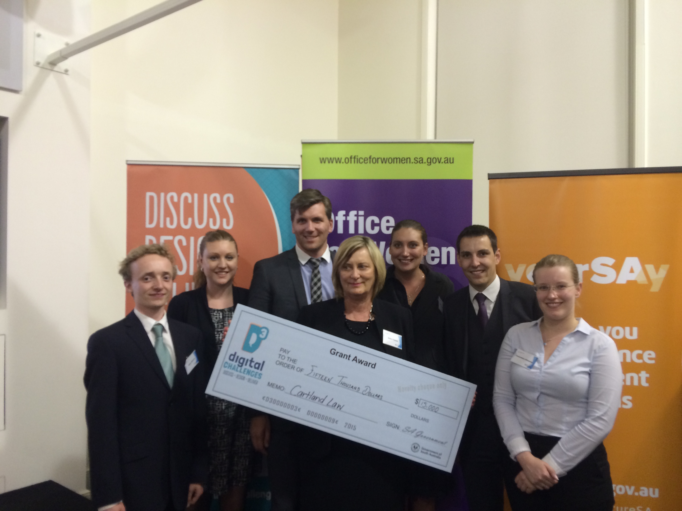
WDVCAS Achievements
Finalist in D3 Digital Challenge in collaboration with a commercial law firm - $15,000 prize money
Recognised at a national level as being amongst the highest performing pro bono practice in Australia
Kiosk at the Adelaide Magistrates Court in 2017

