Slide 1
Skin Diseases in the Top End – Hints for Diagnosis and Management
Dr Jenny Menz

Slide 2
Skin Infections
Fungal
Yeast
Bacterial
Viral
Scabies

Slide 3
Fungal Infections
Dermatophyte
Yeast

Slide 4
Dermatophyte infections
Entirely different pattern of involvement in the top end
Tinea corporis - body, hands and feet
Tinea ungium – nails
Tinea capitis - head

Slide 8
Tinea Corporis
Extensive infections
Enlarging annular scaling plaques from area of original involvement eg axillae and groin
Itch a major symptom
Often modified from topical steroid use
Often long history from childhood
Look for affected nails

Slide 9
Tina Corporis
Diagnosis – Skin scrapings taken from advancing edge with 10 or 15 scalpel blade into black paper or urine specimen jar
Ensure no antifungal cream used for week before.
No use taking scrapings whilst on oral antifungals
Topical steroid enhances chance of getting positive result
Negative microscopy often followed by positive culture
2 -3 sites useful and the scalier the better

Slide 10
Tinea Corporis - Treatment
Topical antifungals – Terbinafine 1% cream superior as fungicidal. All others fungistatic.
Available as RPBS and Authority 2354 & 3243
Lamisil Dermgel excellent for interdigital tinea
Azoles second line – Miconazole, Clotrimazole and Ketoconazole cream

Slide 11
Tinea Corporis - Clinical
Body tinea – DD Tinea Versicolor and Psoriasis – usually Trichophyton rubrum
Groin tinea – DD Intertrigo and Psoriasis
Interdigital tinea – DD Macerated toewebs
Tinea of the palms and soles – DD psoriasis. If vesicular remember Trichophyton Mentagrophytes – granular version. Take blister lid for culture

Slide 12
Tinea Unguim
Tinea of the finger and toenails
Causes destruction of nail plate, onycholysis and white patches in the nail.
Great toenail often affected only.
Often occurs after trauma
Usually painless

Slide 13
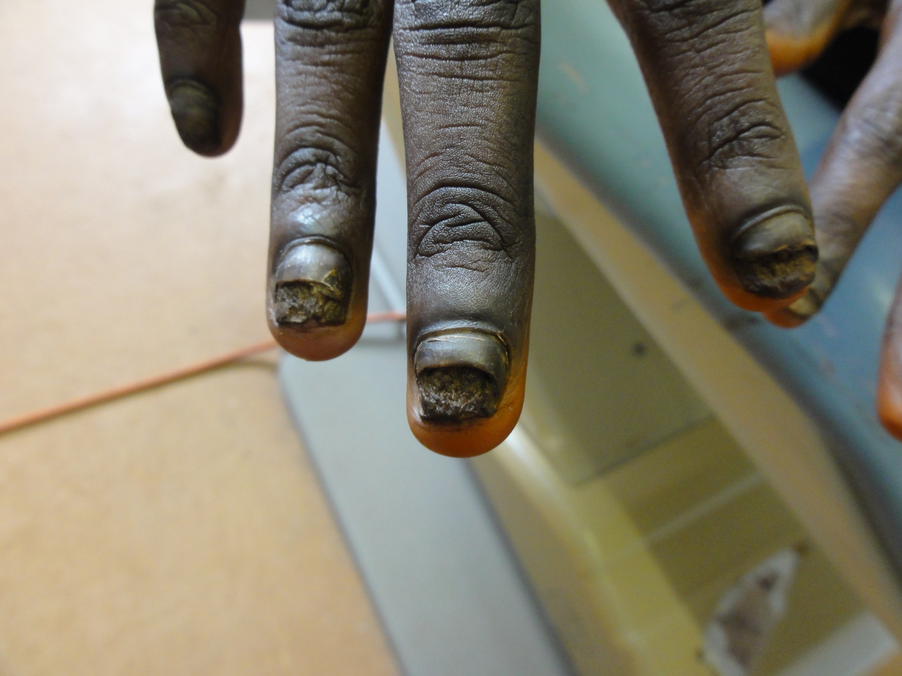

Slide 14
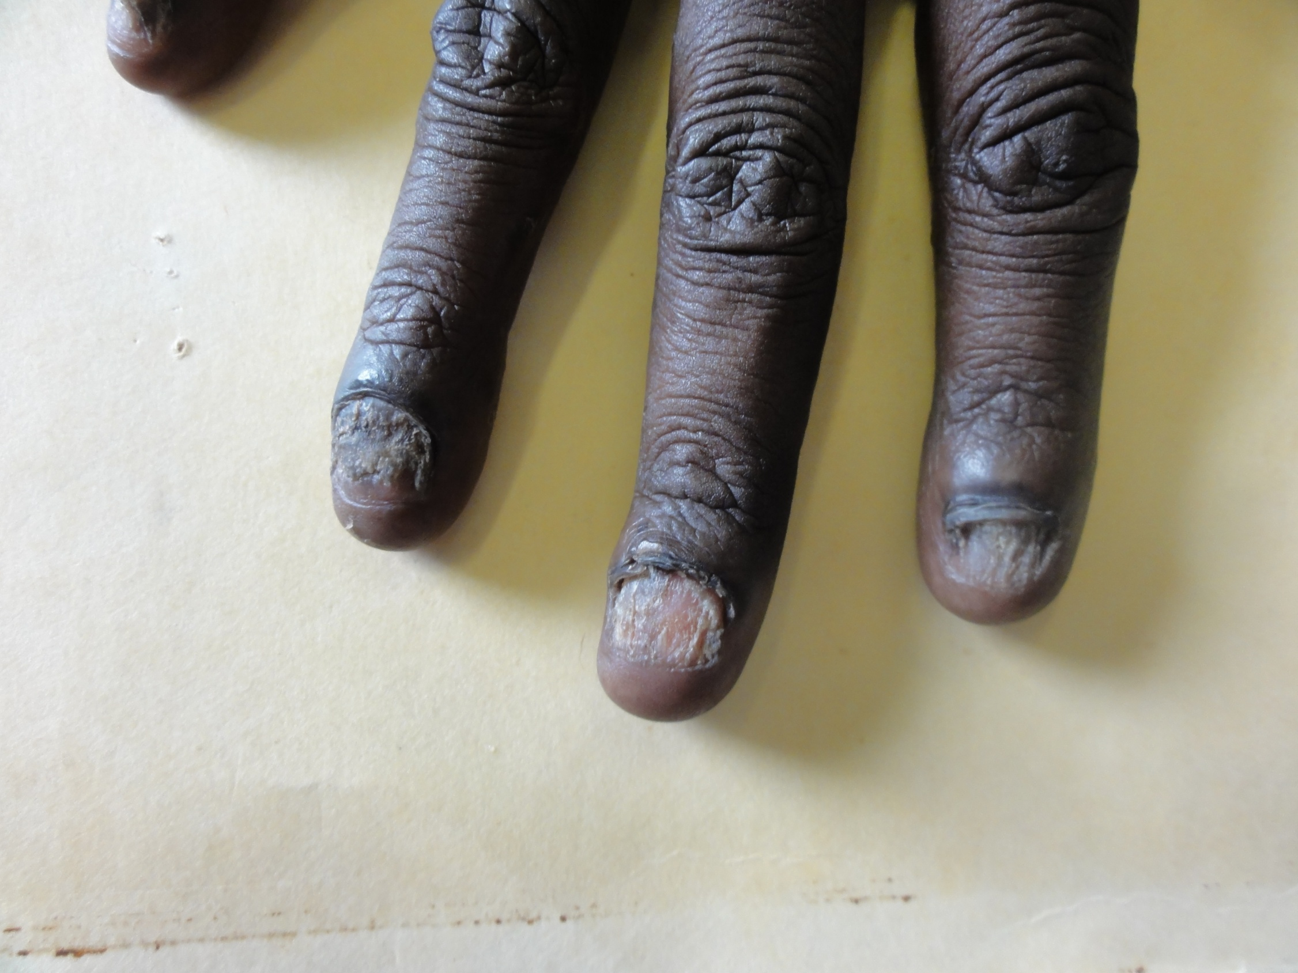

Slide 16
Tinea Unguim
Spreads from nail to nail
Two foot one hand picture
Usually dominant hand
Beware the nail polish!
DD Psoriasis

Slide 17
Tinea Unguim - Diagnosis
Scrapings best taken from crumbly area or white patches
Often false negative results and need repeat scrapings
Look for tinea elsewhere

Slide 18
Tinea Unguim - Treatment
Oral antifungals best.
Griseofulvin – headaches and antabuse effect. Best taken at night time.
Terbinafine – on authority.
Early work on weekly stat doses.
Always needs 3 months of treatment.
Liver function tests before and at 4 weeks.
Avoid alcohol
Taste distortion can occur

Slide 19
Tinea Unguim Treatment
Toenails take 12 months to grow out
Finger nails take 6 months to grow out.
Topical Treatments rarely successful - Loceryl, Daktarin tincture and Lamisil Dermgel
Always trim nails short
Be aware of the risk of cross infection from nail trimming instruments
Can be reinfected at any time in the future so thongs in wet areas

Slide 20
Tinea Capitis - Diagnosis
Extremely common in the top end
Two clinical types
Trichophyton Tonsurans
Inlammatory Tinea Capitis – Kerion. Usually a soil tinea or Microsporum canis

Slide 21
Tinea Capitis – Trichophyton Tonsurans
Common in children of Indigenous origin
Diffuse scaling Dandruff like scalp involvement with or without hair loss
Usually asymptomatic.
Sometimes responds to Selsun gold or Nizoral shampoo.
Often needs oral Terbinafine
Can progress to scarring hair loss

Slide 22
Tinea Capitis - Inflammatory
Kerion – Severe inlammatory plaque with hair destruction. May be misdiagnosed as Bacterial infection.
Common causes – Microsporum canis – look for ringworm elsewhere.
Microsporum gypseum – usually follows injury
Trichophyton tonsurans – Usually non indigenous.

Slide 27
Tinea Capitis – Inflammatory - Treatment
Usually needs Prednisolone plus antifungal orally.
Terbinafine drug of choice
May lead to permanent hair loss
Be aware that hats are vectors
Look for broken hairs – these are best for fungal scrapings. Collect by plucking

Slide 28
Yeast infections
Tinea ( Pityriasis) Versicolor
Candida intertrigo

Slide 32
Tinea Versicolor - Diagnosis
Many colours.
Distribution – scalp is resevoir
Drops down from scalp onto shoulders, chest and upper back
Fine scale throughout lesion – DD tinea
Has preference for sweaty areas
May extend to arms and legs
Can be seen on face of indigenous people

Slide 33
Tinea Versicolor - Diagnosis
Often itchy
Most common in teens and twenties
Thrives in diabetics
Will occur if environment changes to encourage sweating eg synthetic clothing or sport
Skin scrapings – Difficult to diagnose. Not a Dermatophyte so will not have hyphae. Looks like spaghetti and meat balls. Will show up in skin biopsy.

Slide 34
Tinea Versicolor - Treatment
Selsun Gold shampoo – apply for 10 minutes before shower to affected area and then wash off and shampoo hair with same. Perform daily for 3 days and weekly for 3 weeks.
Nizoral 2% shampoo can be used as above but not as effective
Depigmentation takes 6 months to fade
Recurrences common

Slide 35
Tinea Versicolor Treatment
General advice – wear cotton clothing, reduce sweating, shower immediately after sweating or use a clean towel to wipe down areas os sweating, check for diabetes
Oral treatment – Ketoconazole 200 mg orally for 10 days taken with orange juice 30 minutes before sweating
Standard antifungals eg Griseofulvin and Ketoconazole ineffective

Slide 36
Bacterial Skin Infections
Impetigo
Secondarily infected skin infections

Slide 37
Yeast Infections – Candida Intertrigo
Extremely common in the top end
Predisposing factors – Diabetes, Obesity and Immobilty
Clinical – Glazed erythema of skin folds often with satellite lesions
DD - Psoriasis

Slide 38
Candida Intertrigo - Treatment
Non soap wash with Flannel eg QV wash. Adequate hygiene important – a minimum of daily showering
Good drying after shower ? Hair dryer
Cotton clothing and cotton between skin folds
Encourage mobilization
Air conditioning

Slide 39
Candida Intertrigo - Treatment
Hydrozole or Resolve plus 1% - Hydrocortisone and Miconazole – BD
For more severe mix equal quantities of Aristocort 0.02% cream and Canestin and aply bd.
Zinc cream or Daktozin useful at night.
Encourage weight loss

Slide 40
Bacterial Infections - Impetigo
Very common in the top end
Usually children but can be passed to adults – especially family
Usually crusted lesions on the face which spread outwards.
Often around the nose and mouth.
Can be bullous
Extremely infectious

Slide 41
Impetigo
Bacterial swab useful – moisten first if lesion dry.
May be Staphlococcus aureus or Streptococcus pyogenes or both.
Bullous version is always Staph.
Prompt treatment to reduce likelihood of post Strep complications – Glomerulonephritis and Rheumatic Heart Disease

Slide 43
Impetigo - Treatment
Topical Mupirocin 2% bd for 2weeks.
Remove crusts.
Oral Bactrim bd for 5 days.
Penicillin
Often post inflammatory hypopigmentation for months

Slide 44
Bacterial Infections – Secondary infections
Usually complications of scabies and tinea
Bacterial swab important as may have had several courses of antibiotics
Can be superficial infections or deeper – boils ( Furuncles)

Slide 45
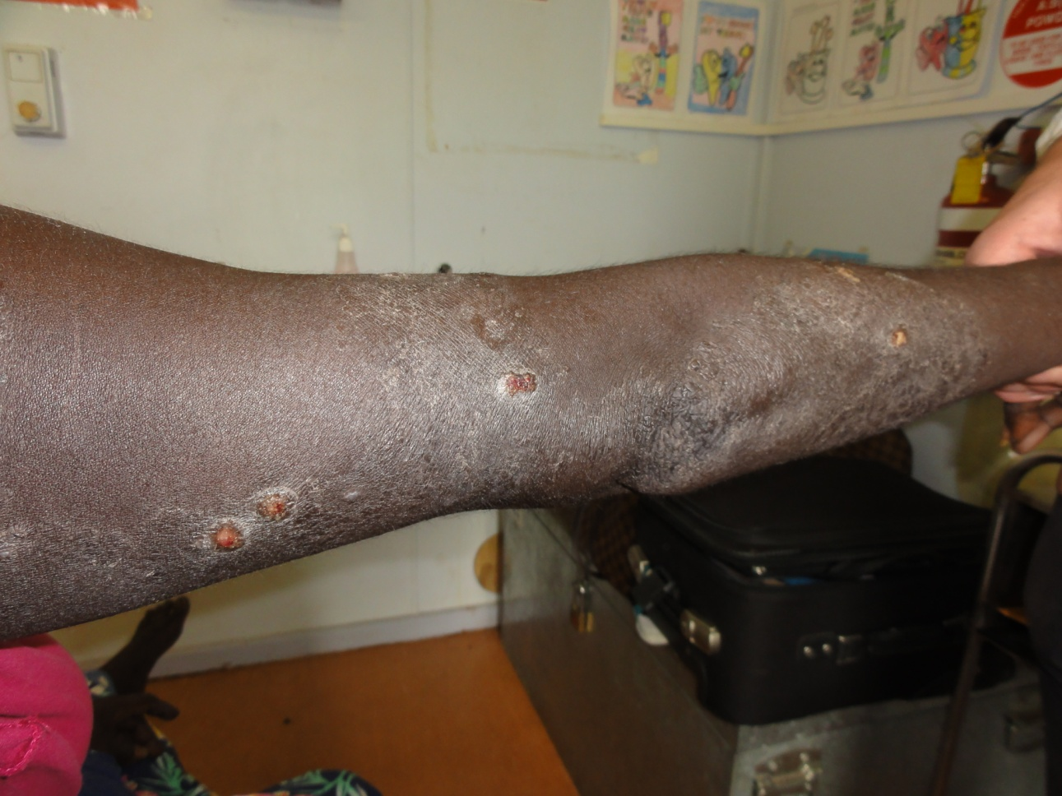

Slide 46
Secondary infections
Similar antibiotic treatment to impetigo
Parenteral benzyl penicillin indicated often.
Bactrim for 5 days effective if compliance ensured
Furuncles may need incision and drainage
Risk of Glomerulonephritis and RHD higher due to recurrent nature of disease
Treat underlying infection

Slide 47
Viral Infections
Warts
Hand Foot and Mouth Disease
Molluscum Contagiosum
Herpes Simplex
Herpes Zoster

Slide 48
Warts - Veruccae
Over 100 different serotypes that cause warts
Most wart infections will settle spontaneously in 2 years
Spread by direct contact or auto innoculation
Look for thrombosed capillary black dot after paring wart - diagnostic

Slide 49
Wart - types
Papilloma
Planter DD punctate planter keratoderma
Filiform
Plane

Slide 52
Viral Warts - Treatment
Occlusion by duct tape
Wart paints – Duofilm paint and gel – use for 12 weeks
Liquid nitrogen cryotherapy – repeat 3 weekly
Oral Ranitidine 300 mg daily for 3 months

Slide 53
Hand Foot and Mouth Disease
Occurs in epidemics in children
3 -5 day incubation period.
May start with fever and mild diarrhoea
Develop pink macules on palms and soles which develop into grey blisters. Oral ulcers also.
Infectious till blisters dry. Stools infectious for 1 month

Slide 58
Hand Foot and Mouth Disiease
Caused by Coxsachie A16 and Enterovirus 71. Also other enteroviruses cause it so can have multiple attacks.
Severe illness in Adults
Can cause spontaneous abortion in Trimester 1

Slide 59
Molluscum Contagiosum
Multiple umbilicated papules which are pearly.
Often occur in moist areas like groin and axillae.
Disease of children and spread through contact, pools and baths.
Usually solitary lesions in adults on face – DD BCC

Slide 62
Molluscum Contagiosum - Treatment
Similar to warts – average duration of infection is 6 months
Duct tape / tape stripping
Duofilm paint
Aldara cream
Watch for secondary eczematization. Treat with topical steroids

Slide 63
Herpes Simplex
Atypical cases
Primary herpetic gingivitis
Herpetic Whitlow
Eczema herpeticum

Slide 64
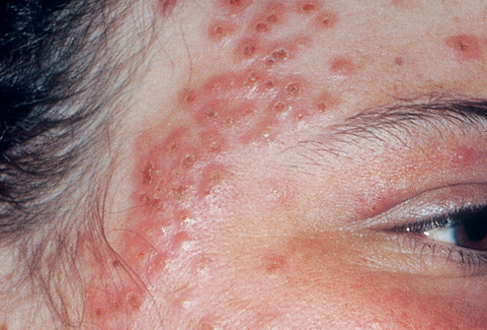

Slide 65
Atypical Herpes simplex
Primary herpetic gingivitis and Eczema Herpeticum require oral antivirals.
Famiciclovir 500 mg tds for 7 days
Herpetic Whitlow infectios and recurrent. Often misdiagnosed as bacterial infection.
Eczema Herpeticum a risk for eye infection and dissemination. Often need hospitaliztion

Slide 67
Herpes Zoster
Reactivation of chicken pox virus in nerve root distribution.
T10 most common site
Beware of the pain in a nerve root distribution – may be a warning sign for HZ
Often misdiagnosed by patients as insect bites as it can look a bit urticarial and be itchy early.
May follow an injury to the spine at the origin of the nerve root

Slide 68
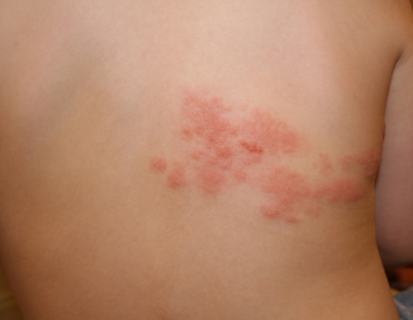

Slide 69
Herpes Zoster
In children and young adults is often painless and mild
Can be recurrent to other nerve root distribution.
Oral Valciclovir indicated to reduce the risk of post herpetic neuralgia

Slide 70
Scabies
10 – 12 mites per person.
Itch develops 3 – 5 days after infection
Night time itch is the hallmark of infection.
Scalp rarely itches
Itch in reinfection develops immediately

Slide 71
Scabies - Clinical
Burrows occur on flexor wrists, sides of fingers, elbows, axillae and soles of feet
Can use Dermatoscope at apex of burrow to see jet plane mark which is the scabies mite
Chronic scabies in adolescents often have few burrows with many excoriations and nodules
Scabies nodules are a sign of chronic infection and take months to clear despite effective scabies treatment

Slide 78
Scabies Treatment
Permethrin 5% cream applied to all skin surfaces from the jawline down. Leave for 12 hours and then shower and wash all clothes, bedclothes and towels on hot wash. Any non washable items should be plastic bagged and stored for 1 week above 20 degrees or Frozen at -20 degrees for 12 hours. Floors and soft furnishings should be vacuumed and favourite chairs either isolated for 7 days or covered with a plastic sheet.
Repeat cream application at 1 week if still itchy

Slide 79
Scabies Treatment
Benzyl Benzoate 25% lotion can be used also but apply a test patch as it can be very irritating. Leave on for 24 hours and reapply at 1 week.
Scabies nodules will often require a strong topical steroid under occlusion eg Dipeosone OV ointment or intralesional steroids to settle

Slide 80
Scabies – The Great Deceiver
Patients with good hygiene will often have few burrows
Scabies appearance is often altered by oral and topical steroids to look like eczema. It may also show a partial response to steroids
Nursing home patients who do not scratch due to dementia and other causes may look like eczema
Babies will often have pustules on the palms and soles

Slide 84
Psoriasis

Slide 89
Discoid Lupus

Slide 90
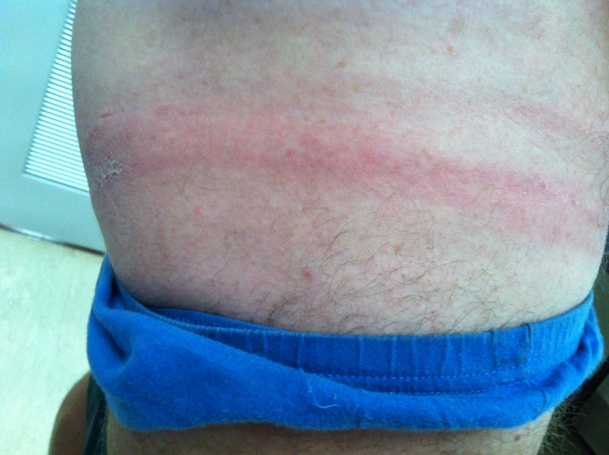

Slide 92
Contact dermatitis

Slide 96
Albinism and Vitiligo

Slide 98
Tattoo reaction

