Slide 1
Improving sexual health outcomes for young Aboriginal and Torres Strait Islander people

Slide 2
Overview of Presentation
Acknowledgements
Access to health services data
Testing
Positivity/Prevalence data
Where to from here?

Slide 3
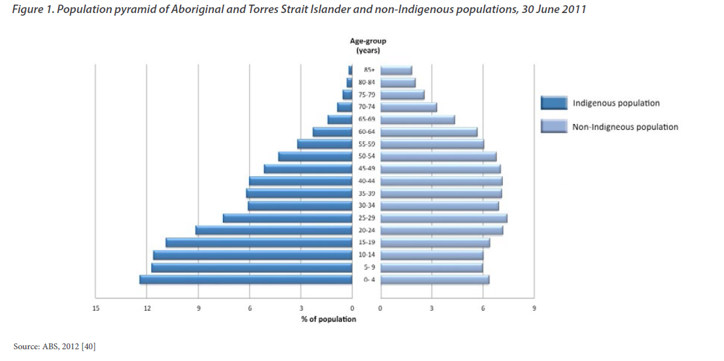
Population pyramid Aboriginal vs non Indigenous Australians

Slide 4
Leading incident conditions
Indigenous 10 – 24 years
Notes:
Unpacking health outcomes amongst Aboriginal adolescents – key incident conditions..

Slide 5
Number of notifications of newly diagnosed chlamydia infections in 2013 by Aboriginal and Torres Strait Islander status¹, sex and age group
Aboriginal & Torres Strait Islander
Non-Indigenous
1 Jurisdictions (NT, QLD, SA, TAS & WA) in which Aboriginal and Torres Strait Islander status was reported for more than 50% of diagnoses each year in the past 5 years
Source: State/Territory health authorities

Slide 6
Notification rates of chlamydia infection in 2013 by Aboriginal Torres Strait Islander status¹, sex and age group
Aboriginal and Torres Strait Islander
Non-Indigenous
1 Jurisdictions (NT, QLD, SA, TAS & WA) in which Aboriginal and Torres Strait Islander status was reported for more than 50% of diagnoses each year in the past 5 years
Source: State/Territory health authorities

Slide 7
Notification rates of gonorrhoea infection in 2013 by Aboriginal and Torres Strait Islander status¹, sex and age group
Aboriginal and Torres Strait Islander
Non-Indigenous
1 Jurisdictions (NT, QLD, SA, TAS, VIC, ACT & WA) in which Aboriginal and Torres Strait Islander status was reported for more than 50% of diagnoses each year in the past 5 years
Source: State/Territory health authorities

Slide 8
Chlamydia and gonorrhoea by remoteness

Slide 9
Notification rates of chlamydia infection by Aboriginal and Torres Strait Islander status, State/Territory¹ and year
Aboriginal and Torres Strait Islander
Non-Indigenous
1 Jurisdictions (NT, QLD, SA, TAS & WA) in which Aboriginal and Torres Strait Islander status was reported for more than 50% of diagnoses each year in the past 5 years
Source: State/Territory health authorities

Slide 10
Notification rates of gonorrhoea infection by Aboriginal and Torres Strait Islander status, State/Territory¹ and year
Aboriginal and Torres Strait Islander
Non-Indigenous
1 Jurisdictions (NT, QLD, SA, TAS, VIC, ACT & WA) in which Aboriginal and Torres Strait Islander status was reported for more than 50% of diagnoses each year in the past 5 years
Source: State/Territory health authorities

Slide 11



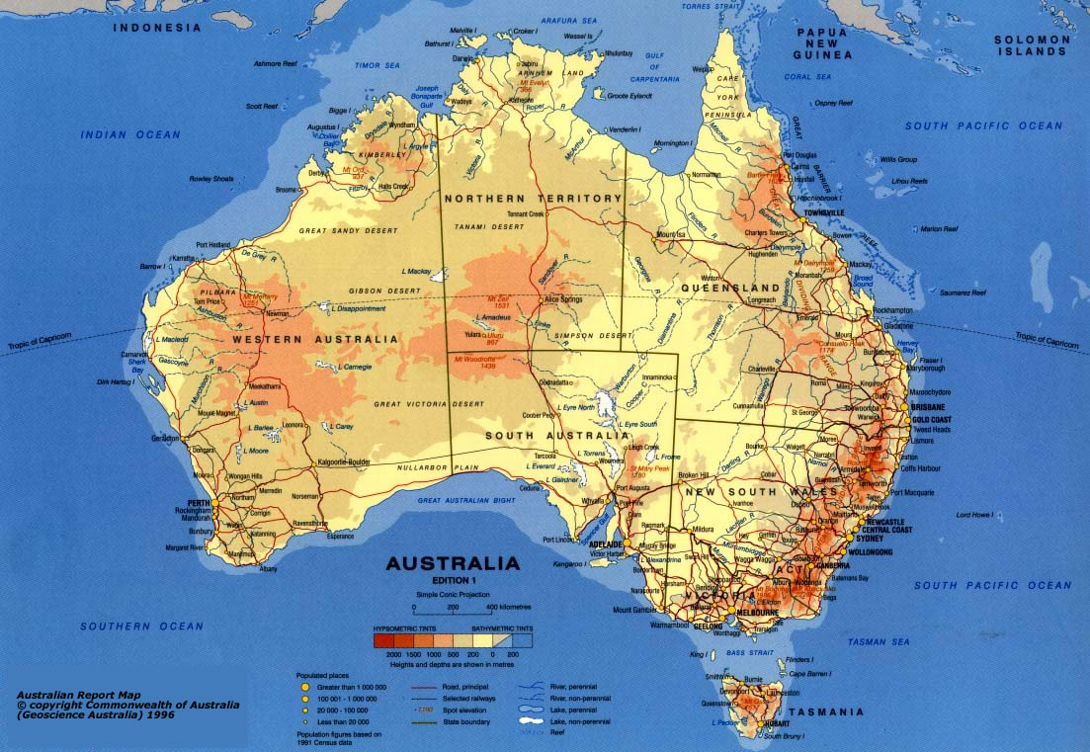
Syphilis outbreak in northern Australia 2011-2015: the epidemiology and public health response

Slide 12
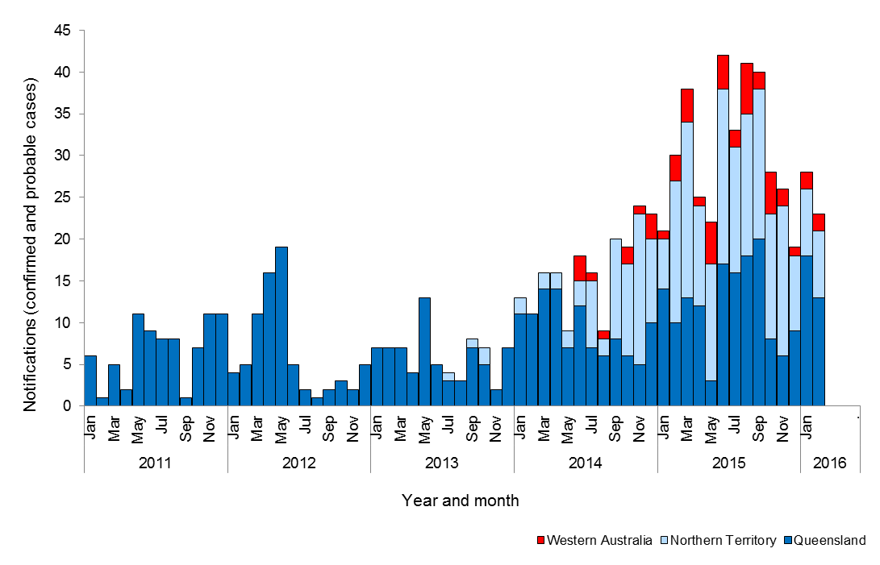
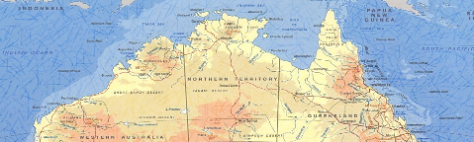
Infectious syphilis notifications in affected regions of Queensland, the Northern Territory and Western Australia,
Notes:
Qld – 510
NT- 277
WA - 51

Slide 13
ACCESS to HEALTH SERVICES

Slide 14
SHIMMER: Health care attendance over 3 years, 4 regional AMS in NSW

Slide 15
Health care access NSW sites

Slide 16
Health service use, by sex and age, 2010 ( FNQ)
Notes:
Looks at what proportion of the community attend the health centre over the course of one year.
16 – 34 year old Women = 89%
16 – 34 year old Men = 72% attending within one year
Women. 16-19 = 85%, 20-24 = 90%, 25-29=97%, 30-34= 81%
Men. 16-19 =75%, 20-24=75%, 25-29=65%, 30-34 = 73%

Slide 17
Access Summary
Men accessing clinics
Do so ~ one third less than women
Often with symptoms (prevalence study less cases detected than in usual period
Attendance increases with age

Slide 18
STI Testing Outcomes

Slide 19
STI testing
Clinical guidelines
Guidelines recommend annual testing of 15-29 year olds for chlamydia
Test for reinfection
Full STI screening after a positive diagnosis

Slide 20
Total STI testing by calendar year

Slide 21
CT & NG testing coverage, by year females

Slide 22
CT & NG testing coverage, by year, males

Slide 23
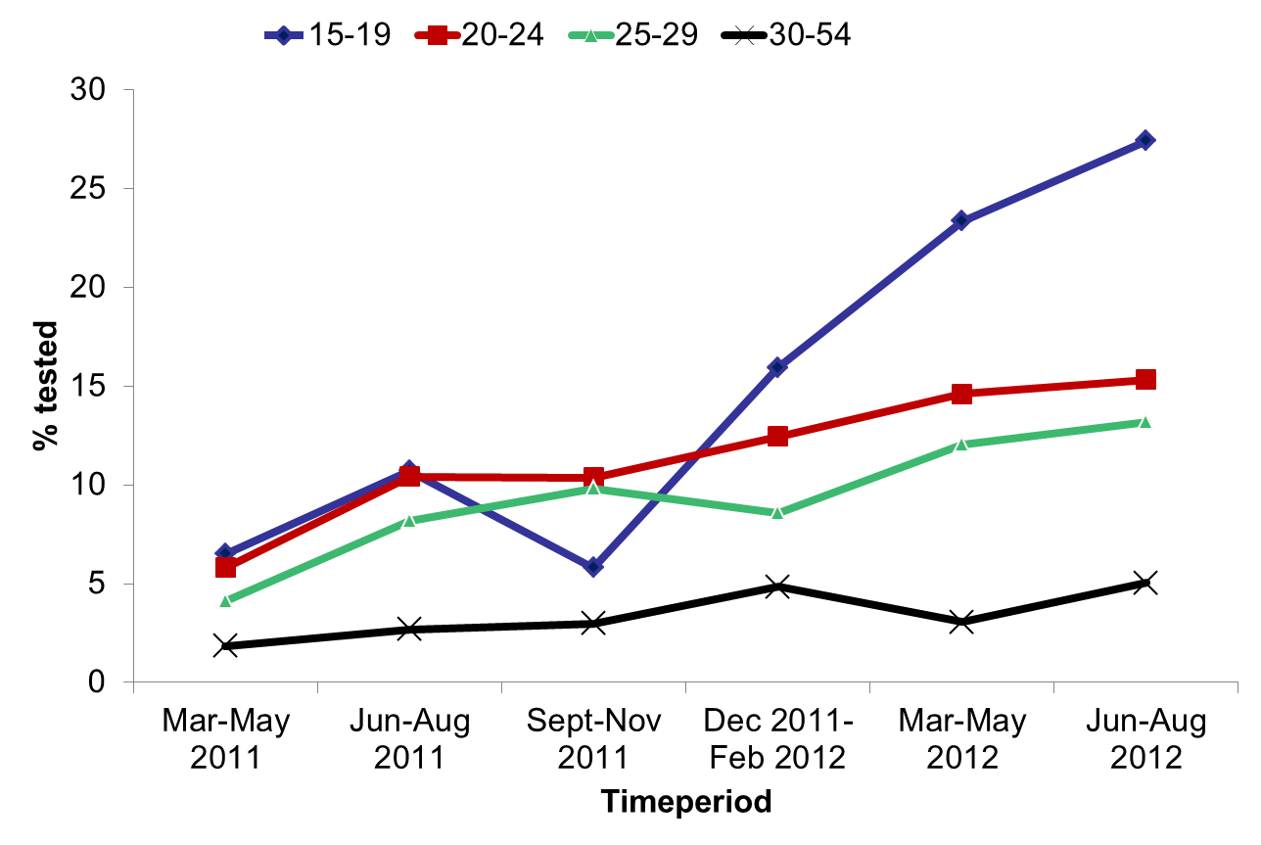
% females tested for chlamydia,
2011-2012 n=6,259
Graham, BMC Inf Dis 2015

Slide 24
% females tested for chlamydia,
2011-2012 n=6,259
P<0.01
P=0.16
P=0.19
P=0.96

Slide 25
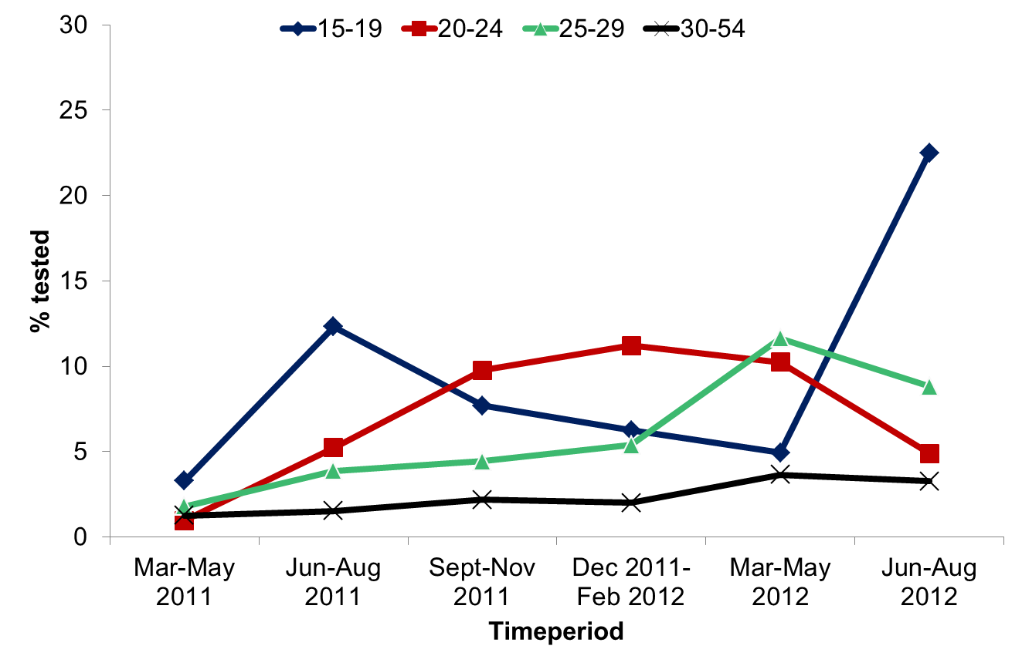
% males tested for chlamydia,
2011-2012 n=6,259
Graham, BMC Inf Dis 2015

Slide 26
% males tested for chlamydia, 2011-2012 n=6,269
P=0.04
P=0.38
P=0.03
P=0.05
Graham, BMC Inf Dis 2015

Slide 27
ACCESS: Chlamydia testing rate by service type, 2009
Ward 2012 ANZJPH

Slide 28
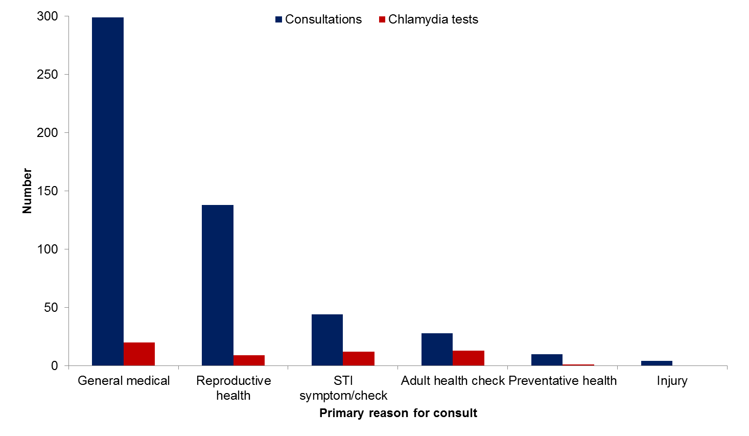
Primary reason for consultations & chlamydia tests in females, 2011 ( Audit) n=523
General medical includes: Ear, nose & throat, respiratory tract infection, skin, immunisation, breast lump, hypothyroid, dizziness, migraine, referral.
Reproductive health includes: pregnancy testing, contraception

Slide 29
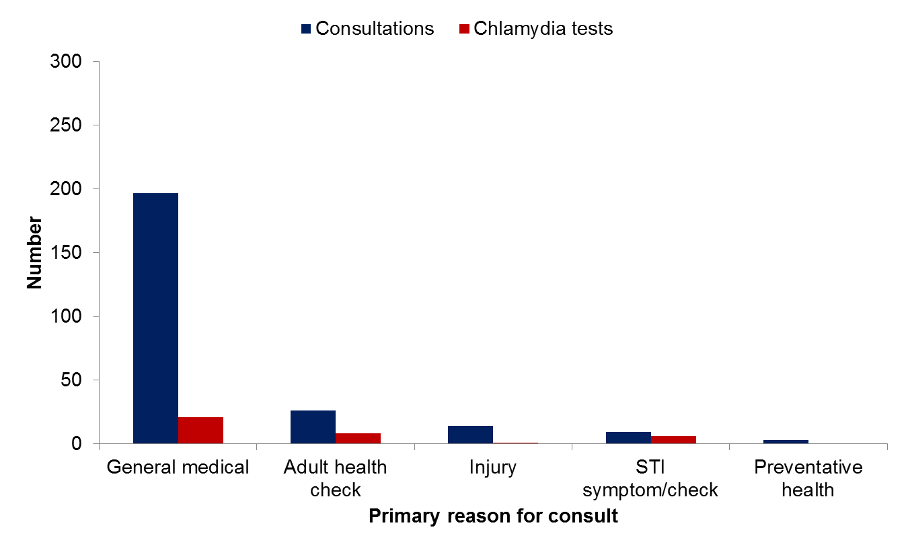
Primary reason for consultations & chlamydia tests in males, 2011 (n=249)
General medical includes: Ear, nose & throat, respiratory tract infection, weight loss, back pain, smoking, epilepsy, boostrix & medical certificate.

Slide 30
Low retesting rates and high positivity
Baseline CT/NG laboratory data (2009 to 2010) from 66 participating remote health
2,054 people diagnosed with CT and/or NG in the study period
Retested
15.4% <2 months,
14.9% in 2-4 months,
26.9% in 5-12 months
41.8% overall.
Repeat positivity
24.2% in those retested in <2 months,
26.1% at 2-4 months,
27.0% in 5-12 months
28.2% overall (2-12 months).
Garton et al, In press Sex Health

Slide 31
Where are the gaps- STIs?
Testing for STIs
Recommendation is all 16-29 year olds test annually for STIs and more often where prevalence is higher
What usually occurs- ranges (5%- 40%) of people tested
Testing for re-infection
Recommendation that all be tested around 3months after a + ve diagnosis
Ranges (20%- 40%)
Context of testing
Aside from antenatal testing and a small proportion of STI tests done during 715s very little testing occurs opportunistically particularly in urban and regional settings

Slide 32
STI Positivity Prevalence

Slide 33
ACCEPt: Chlamydia prevalence in 16-29 year olds
Yeung MJA 2014

Slide 34
STRIVE STI co-infections in remote Aboriginal communities: females
Guy et al STI 2014

Slide 35
STRIVE: STI co-infections in remote Aboriginal communities: males
Guy et al STI 2014

Slide 36
STRIVE: Trichomonas prevalence in 16-34 year olds, 2010 (n=1828)

Slide 37
Chlamydia positivity in A&TSI 15-29 year olds
attending SHCs, 2007-2014, by sex
Source: ACCESS 2015

Slide 38
SHIMMER : CT and NG positivity
Graham, Sex Health 2015

Slide 39
Summary Positivity/Prevalence
Disparate rates of diagnosis between non Indigenous and Indigenous young people
Highest prevalence of STIs occur among 16-19 year olds irrespective of setting
Higher rates in remote communities, including high prevalence and incident infections

Slide 40
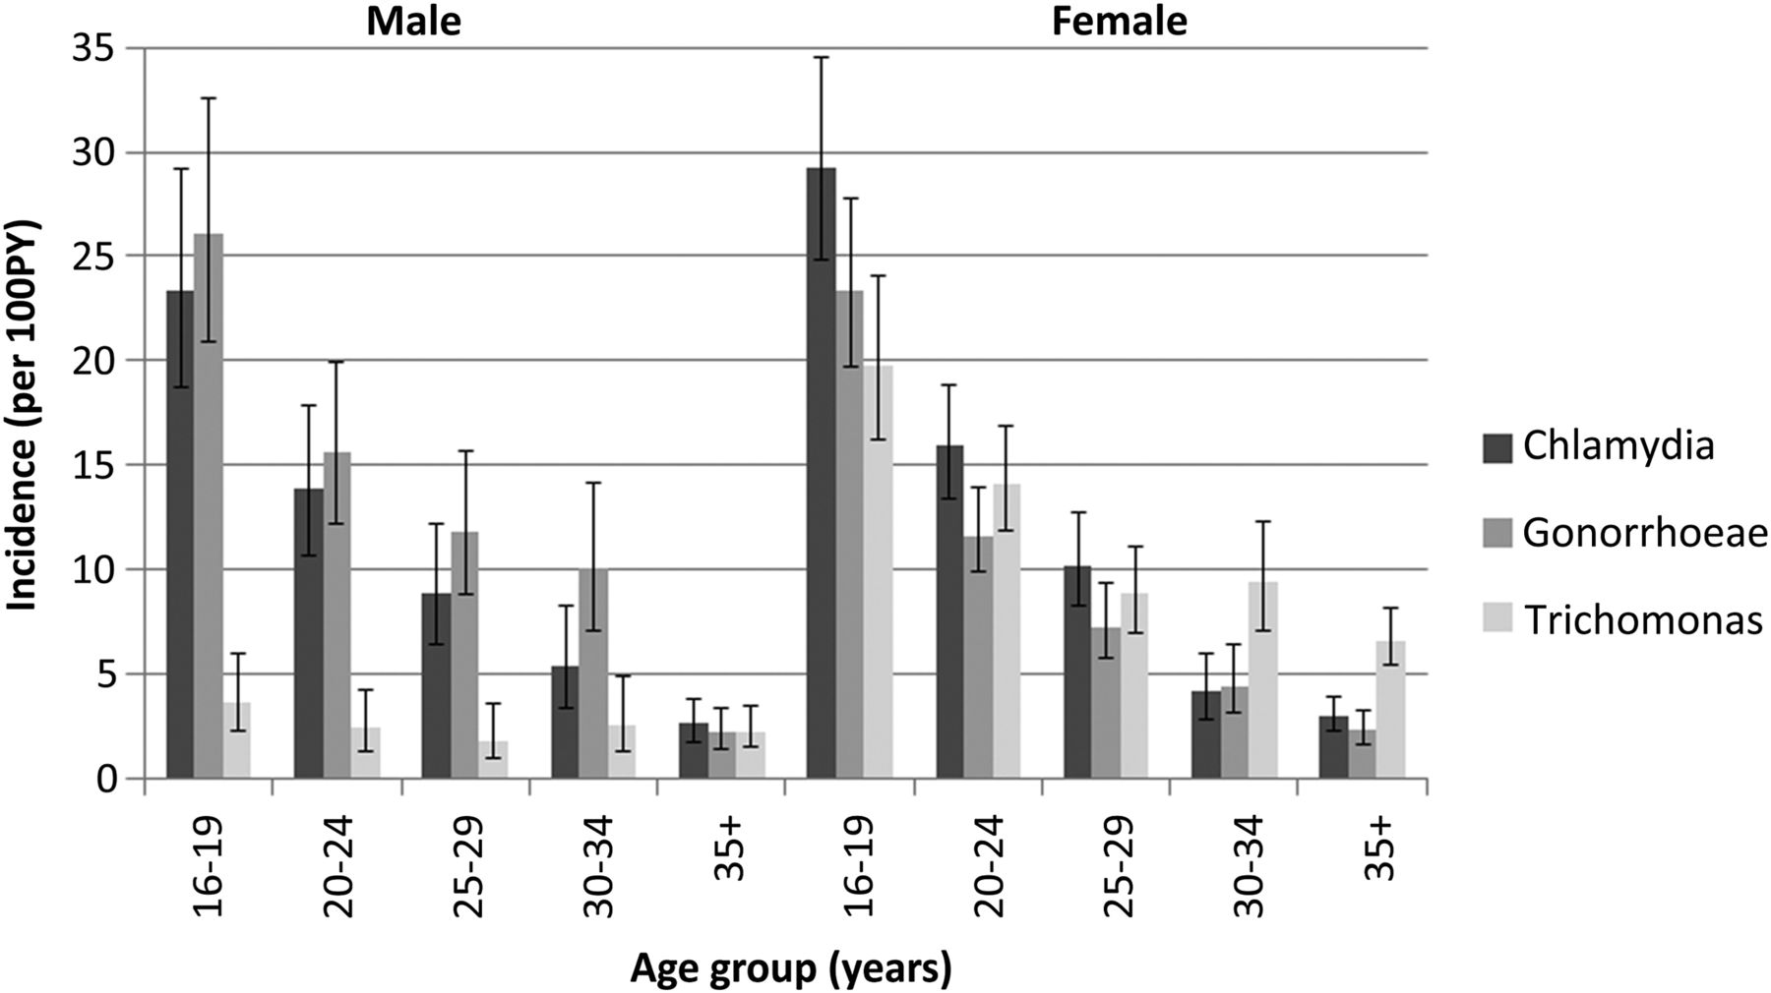
Incidence data
SHIMMER NSW
STRIVE

Slide 41
HIV and STIs
Strong evidence indicates that both ulcerative and non-ulcerative STDs promote HIV transmission by augmenting HIV infectiousness and HIV susceptibility via a variety of biological mechanisms.
The risk estimates found in numerous studies from four continents which range from 2.0 to 23.5, with most clustering between 2 and 5.
Owing to the greater frequency of non-ulcerative STDs in many populations, these infections may be responsible for more HIV transmission than genital ulcers.

Slide 42
HIV diagnosis among Aboriginal Australians

Slide 43
Proportion of HIV diagnoses in Indigenous people due to exposure risks, by 4-year time block, 1994-2013

Slide 44
Rolling average of Indigenous HIV notification rates - 1994-2013

Slide 45
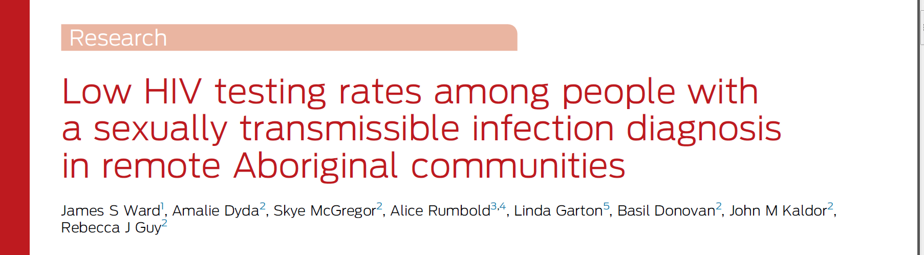
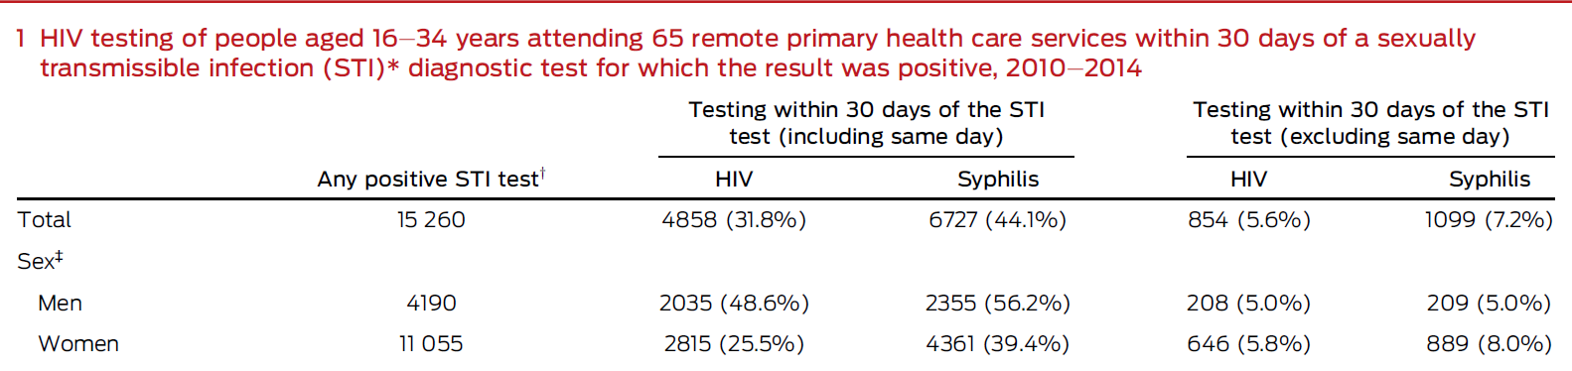
MJA August 15 2016

Slide 46
Where are the gaps?
HIV testing after a +ve STI diagnosis – 100% recommended
Ranges from 20%- not higher than 30%
Most done on same day as initial STI tests (<10% done within 30 days)
Gender differences

Slide 47
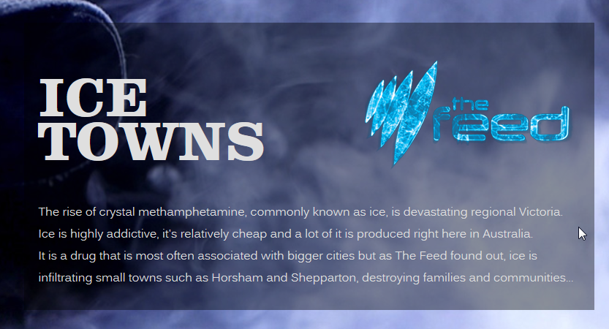

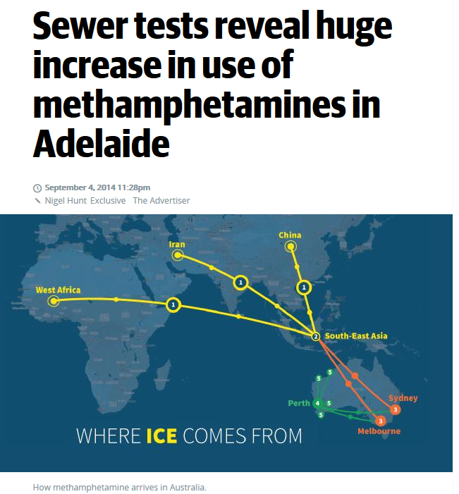
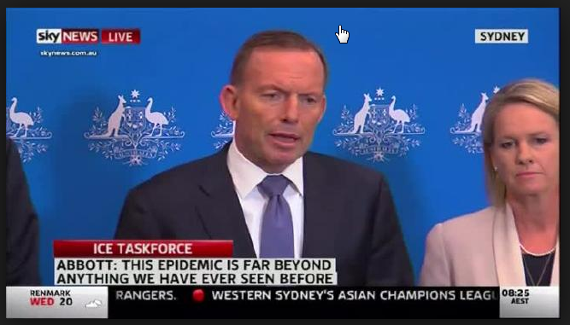
Media….The ice ‘epidemic’

Slide 48
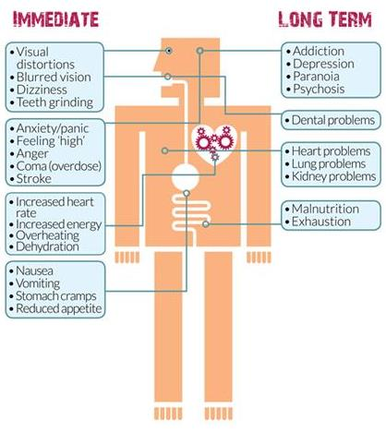
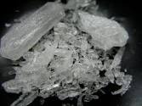
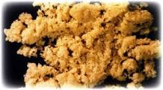
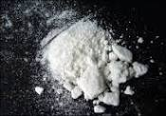
Methamphetamine
Methamphetamine: ice, meth, crystal meth, crystal, chalk, base or fire.
Ice Base
Speed
Potent, illegal, addictive

Slide 49
GOANNA Survey–National Survey of people aged 16-29 years
Cross-sectional survey 40 community events.
n=2,877
Injecting in last 12months was reported by 3%
A high incidence of needle sharing (37%).
Methamphetamine (37%), heroin (36%) & methadone (26%) were the most commonly injected drugs
Injecting was related to prison involvement (AOR 5.3 95% CI 2.8-10.0).
Bryant J, Ward J, et al Drug Alcohol Rev. 2015 Sep 15.

Slide 50
GOANNA – meth use
Methamphetamine use in the last year- 9% overall, 13% among sexually active ( 17% men 10% women)
Need for better data to guide community responses

Slide 51
Queensland
Surveys of both 304 community leaders and 963 community members in regional and remote communities in Queensland during 2013/14, raised a number of diverging views about the use of amphetamine-type stimulants (ATS), including ice.
No similar reports during the preceding 15 years in FNQ.
“They are being introduced to ecstasy, ice, when they go in to [nearby town]. Utensils were found in the school ground last year, needles. They are opened up to another world of drugs”
“People are wanting education about ice. They know nothing about it. They put it on top of bongs. We have ice users in [nearby regional town]”
“There is a rumour that ice is in the community.”
Ref: Clough A, Fitts M, Robertson J. Med J Aust 2015; 203 (1): 19.

Slide 52
Methods – gathering data
PHASE 1/2
Cross-sectional survey:
80 recent meth users (past 12mo.) in each community
Age 16+
Used meth at least twice last year
n=720 collected on electronic tablets
(i) Aboriginal community members affected by and/or concerned about MA use in their community;
Service providers and other stakeholders
MA users.
PHASE 1/2
Focus groups with 3 different groups
Notes:
Analysis of each of the focus groups will be conducted to inform phases 3 and 4 of the study.

Slide 53
Methods – community and clinical interventions
PHASE 3
‘Communities that Care’
Form a community coalition.
Collate data on risk and protective factors.
Community and research team partner to implement evidence-based programs and strategies to address top 5 action areas.
Evaluation
PHASE 2
PHASE 4
Trial of a web-based tool for use in PHC
Development of a web-based therapeutic intervention (WBTI)
CBT and MI techniques.
A wait-list control, randomised trial design

Slide 54
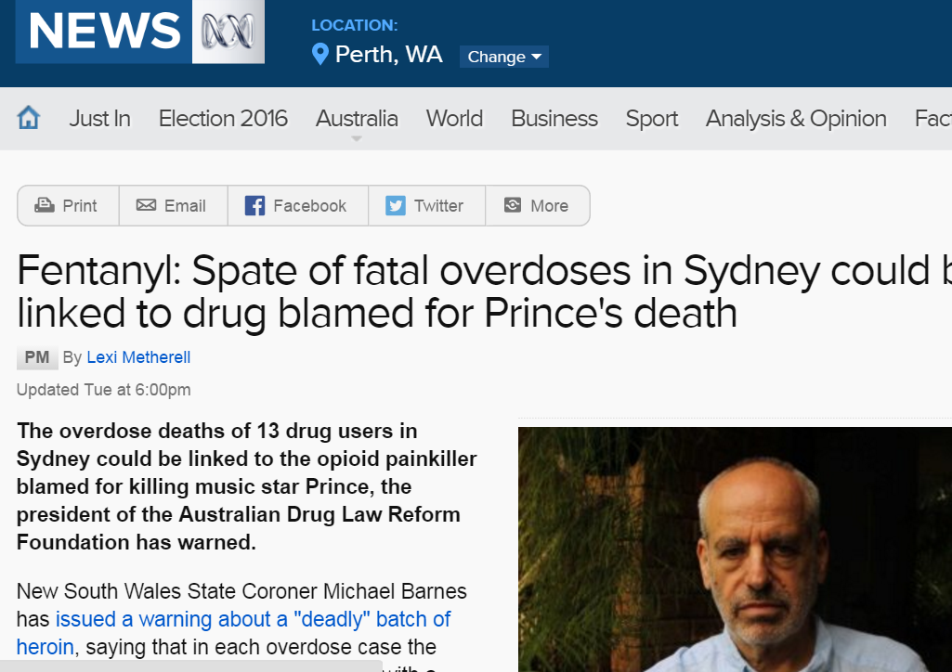
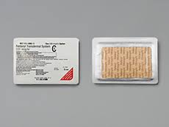
Fentanyl
Fentanyl ( the patches) is a potent, synthetic opioid analgesic with a rapid onset and short duration of action.

Slide 55
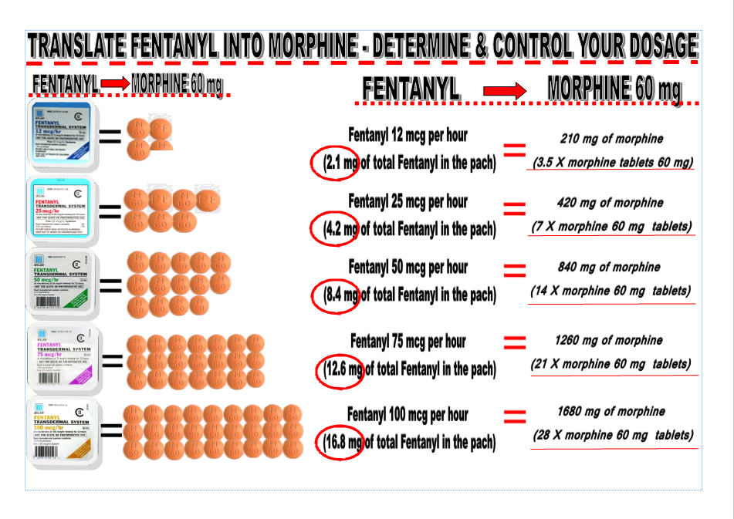

Slide 56
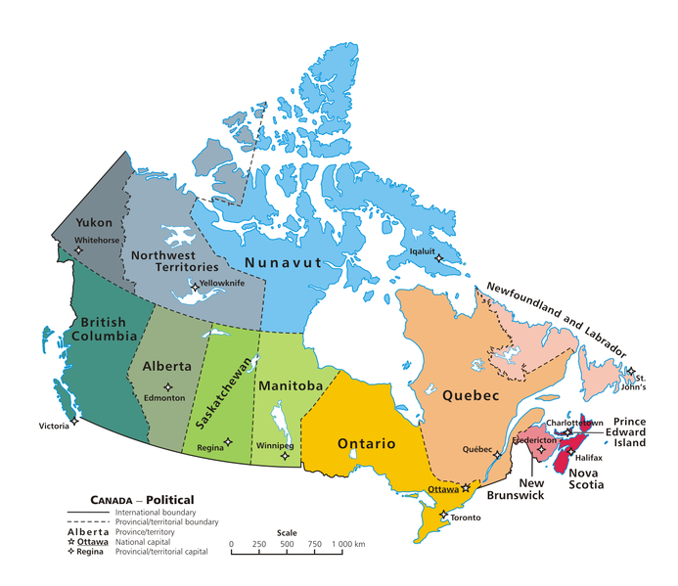
Lessons from Canada
Aboriginal and First Nations, Metis and Inuit make up 4% of the population
Where reported Aboriginal peoples make up ~20% of HIV diagnosis

Slide 57
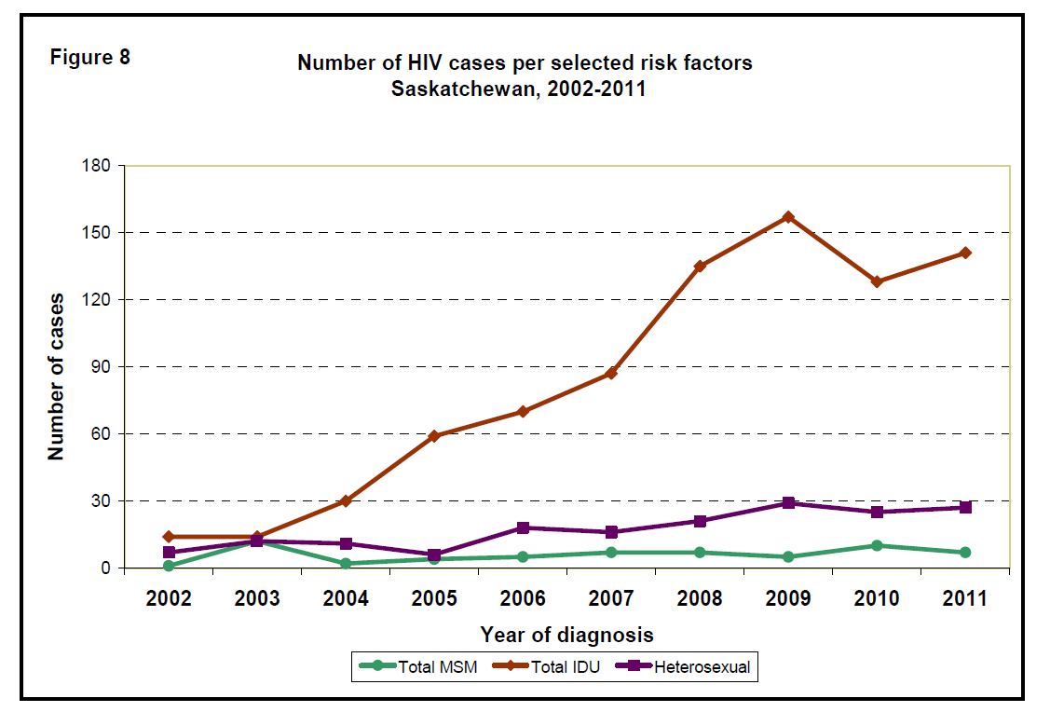
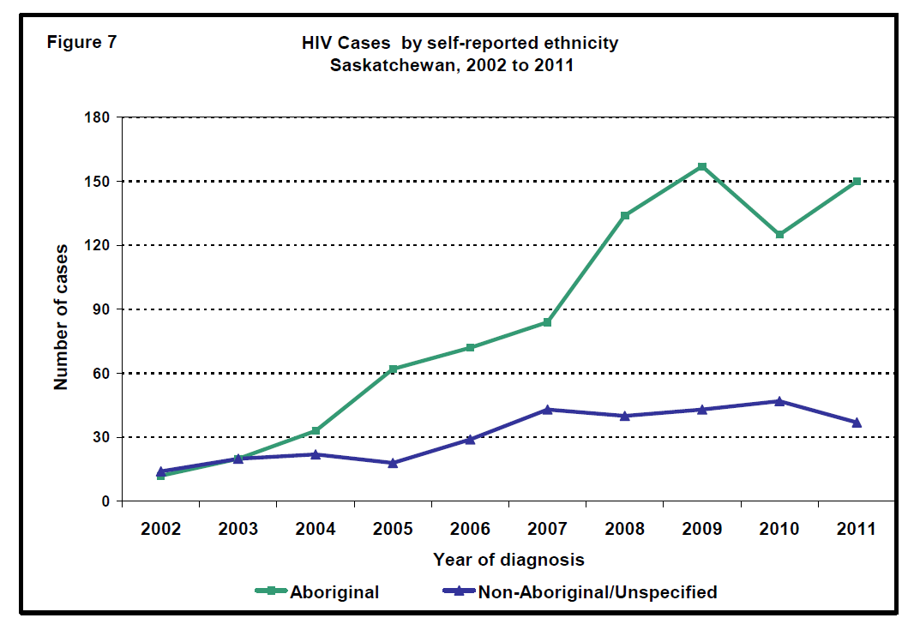
Saskatchewan- Canada

Slide 58
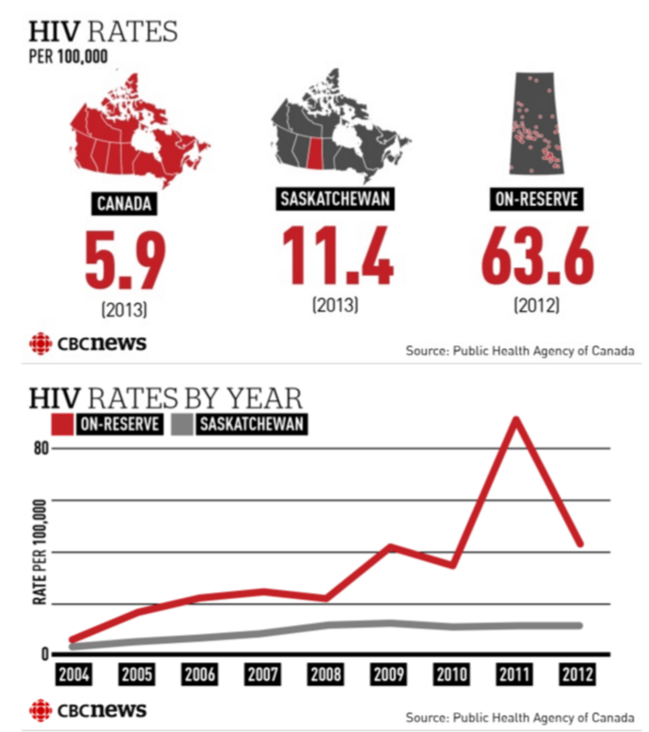

Slide 59
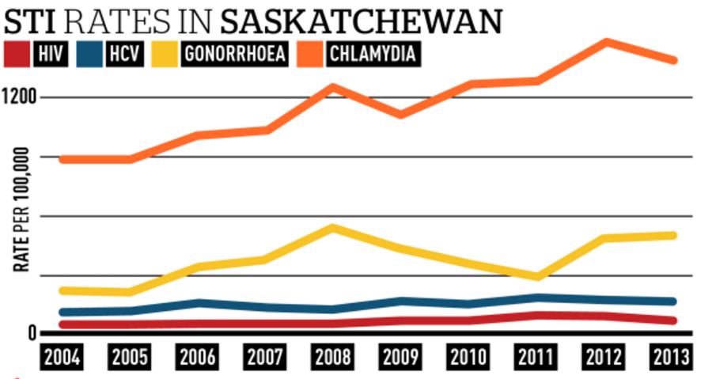
STI rates in SK

Slide 60

Centre of Research Excellence

Slide 61
CRE Aims
New knowledge- research
Translation
Capacity building

Slide 62
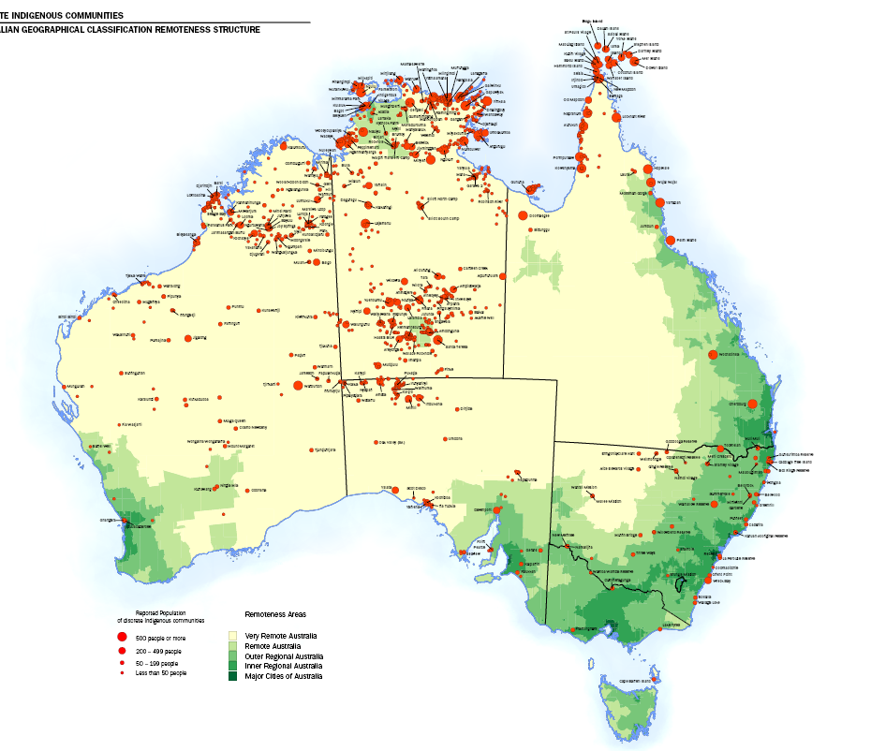
5 clinical hubs and partners
Apunipima Cape York Health Service
Kimberly Aboriginal Medical Services
Institute for Urban
Indigenous Health
Aboriginal Health and Medical Research Council of NSW
Aboriginal Health Council of South Australia

Slide 63
Core project- National surveillance project
Establish a national surveillance network of ACCHS and other PHC sites working with Aboriginal communities to improve our understanding of STIs and BBVs
Aiming for around 40 ACCHS to participate (urban, regional and remote)
Why?- currently rely on notification data- no testing data, no treatment data, no behavioural data, no accounting for service characteristics

Slide 64
New Work – DoH
Syphilis Education Testing Campaign
In response to syphilis outbreak
Comprising TVC and Radio media buy
Animation
Peer online educators
Zone and Regional Activation
Commenced

Slide 65
Remote STI Initiative
Portal Website
Go to place for resources information for community and professionals
Clinician Video Podcasts
Fact Sheets (for parents carers, teachers)
Animations ( TBD)
Guidelines (All jurisdictions with remote)
Peer Educators trial (10 communities)
Health promotion posters (STIs and HIV with titles, key messages & call to action)
Able to be modified to input own language and using own pics and with own logos)

Slide 66
Key points
Test test, test for STIs 16-29 particularly for CT, NG and TV
Particularly target young men and those who don’t come to clinic
Be alert for syphilis
HIV testing after a positive diagnosis
HIV testing
Screening for drug use (IDU, meth, other)

