Slide 1

Diabetes management:
There’s Never Been a Better Time!
Dr Elaine Pretorius
Divisional Director, Medicine, NALHN
August 2016

Slide 2

There’s Never Been a Better Time in Diabetes Management!

Slide 3
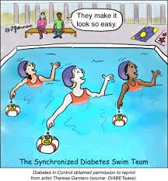
What will we discuss?
Background and Pathophysiology
Targets
Case Studies
Some news from the ADA

Slide 4
Background and Pathophysiology

Slide 5
Background and pathophysiology
1.1 million Australians with diabetes
Another 1 million undiagnosed
280 patients diagnosed every day
$ 10 billion dollars per year

Slide 8
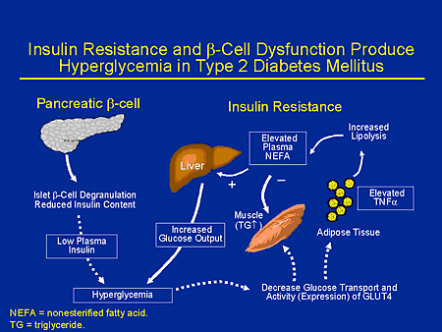

Slide 9
UK Prospective Diabetes Study
20-year Interventional Trial from 1977 to 1997
5,102 patients with newly-diagnosed type 2 diabetes recruited between 1977 and 1991
Median follow-up 10.0 years, range 6 to 20 years
Results presented at the 1998 EASD Barcelona meeting
10-year Post-Trial Monitoring from 1997 to 2007
Annual follow-up of the survivor cohort
Clinic-based for first five years
Questionnaire-based for last five years
Median overall follow-up 17.0 years, range 16 to 30 years
Notes:
9

Slide 10
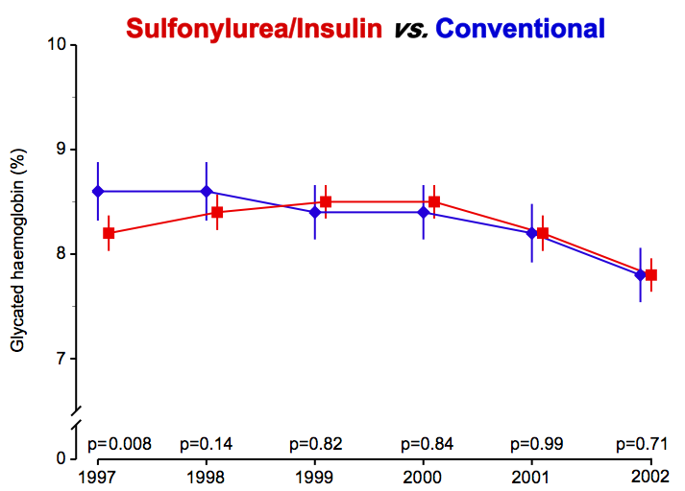
Post-Trial Changes in HbA_{1c}
Mean (95%CI)
UKPDS results
presented
Notes:
10

Slide 11
Legacy Effect of Earlier Glucose Control
After median 8.5 years post-trial follow-up
Aggregate Endpoint 1997 2007
Any diabetes related endpoint RRR: 12% 9%
P: 0.029 0.040
Microvascular disease RRR: 25% 24%
P: 0.0099 0.001
Myocardial infarction RRR: 16% 15%
P: 0.052 0.014
All-cause mortality RRR: 6% 13%
P: 0.44 0.007
RRR = Relative Risk Reduction, P = Log Rank
Notes:
11

Slide 12
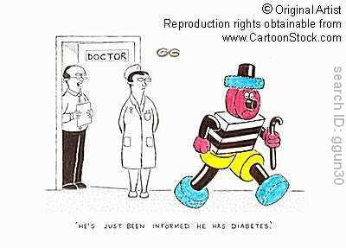
Targets

Slide 13
ADS Position Statement
New diabetes, no CV disease | 53 mmol/mol (7%) OR LESS
CV disease, other co-morbidities | 64 mmol/mol ( 8%)
Limited life Expectancy | Symptom control
Planned pregnancy | 42 mmol/mol (6%)

Slide 14
Advice: It is easy now!

Slide 15
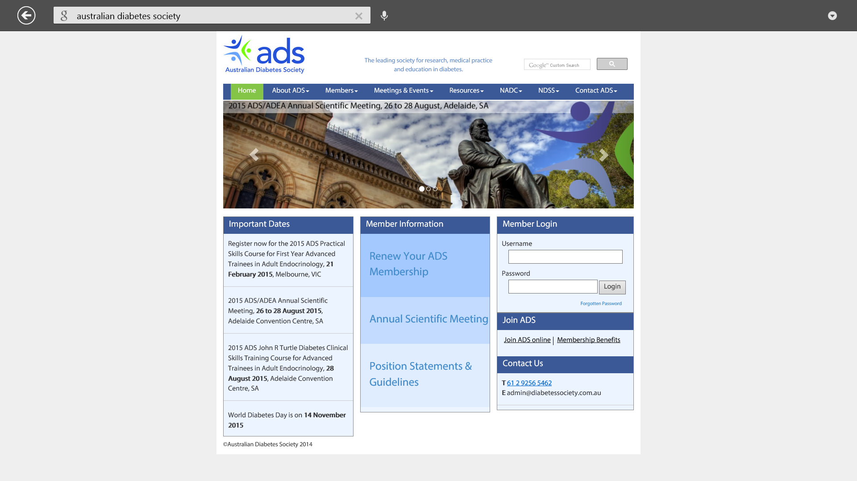

Slide 16
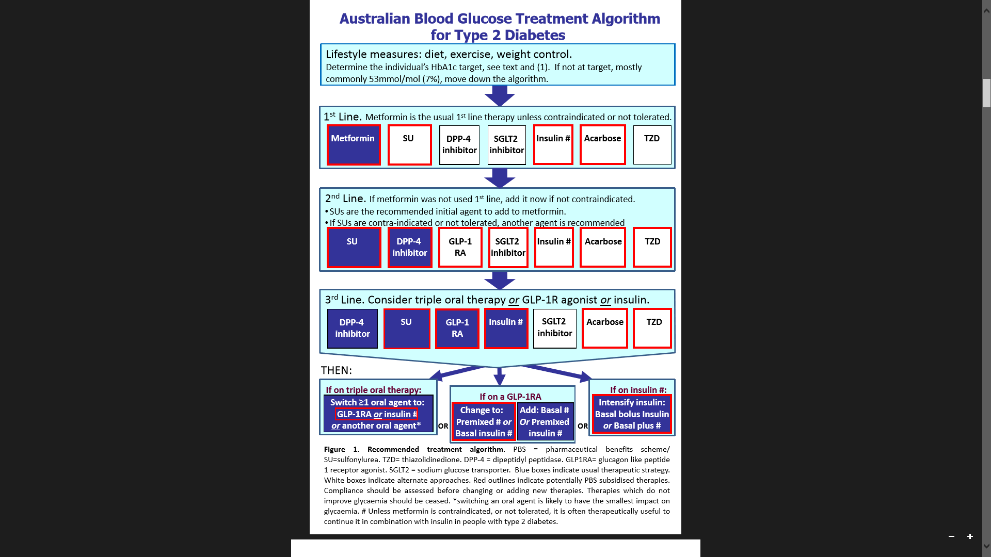

Slide 17
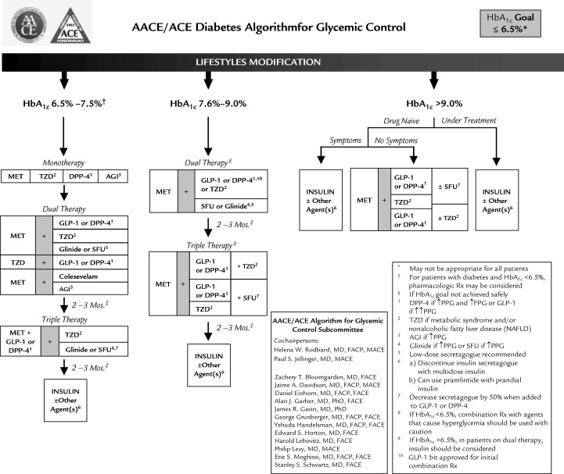

Slide 18
Case Studies

Slide 19
Pretorius Principles
Contra-indications?
  Renal
  Hepatic
  Pancreatitis
  WEIGHT GAIN
What target?
What HbA1C reduction am I looking for?
If elevated fasting glu > 12, HbA1C>9%: INSULIN

Slide 20
Case Study 1
Mr PB

Slide 21
Mr PB
52 yr old taxi-driver
Morbidly Obese: w=123 kg
HT, Hypercholesterolaemia, OSA
Severe depression and anxiety
T2 DM, 8 years, Metformin 850 mg bd
HbA1C: 8.8%
What reduction?

Slide 23
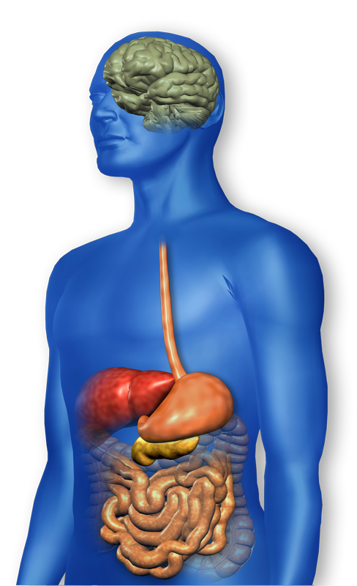

GLP-1 Effects in Humans: Understanding the Glucoregulatory Role of Incretins¹⁻⁵
GLP-1 secreted upon the ingestion of food
↓ β - cell
workload
Promotes satiety and
reduces appetite
Alpha cells:
↓ Postprandial
glucagon secretion
Liver:
↓ Glucagon reduces hepatic glucose output
β cells:
Enhances glucose-dependent insulin secretion
Stomach:
Helps regulate gastric emptying
Adapted from a review article and clinical studies on the actions and effects of incretin hormones.
1. Nauck MA et al. Diabetol 1993;36:741-4. 2. Zander M et al. Lancet 2002;359 :824-30. 3. Larsson H et al. Acta Physiol Scand 1997;160:413-22. 4. Flint A, et al. J Clin Invest. 1998;101:515-520 5. Drucker DJ. Diabetes. 2003;26:2929-2940

Slide 24


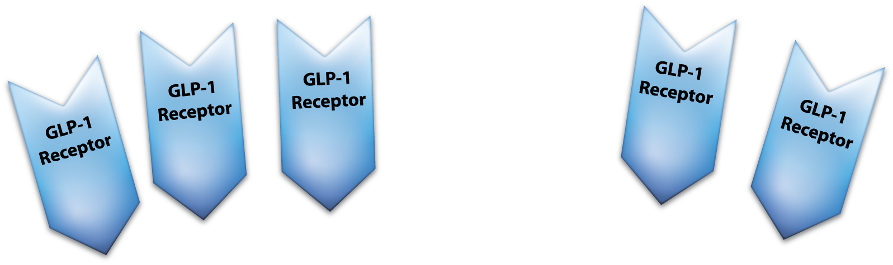
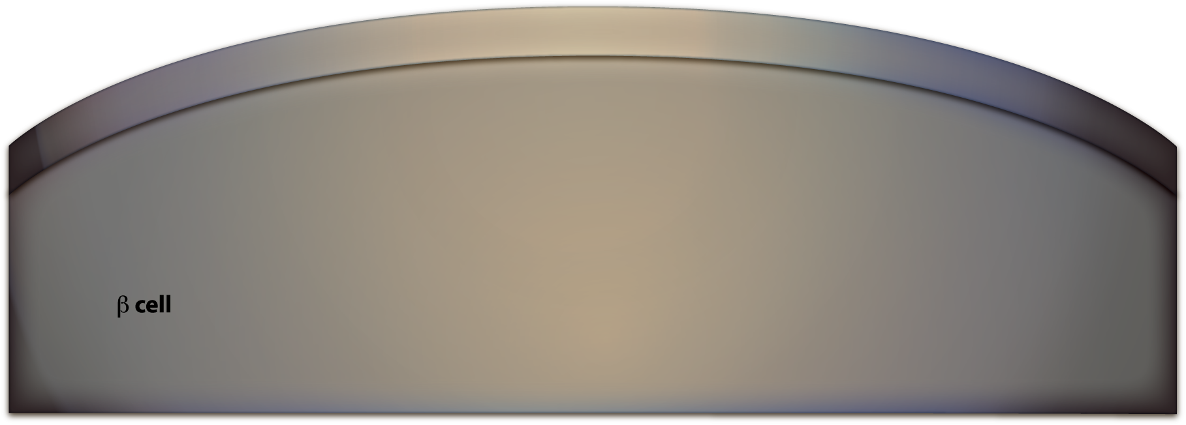
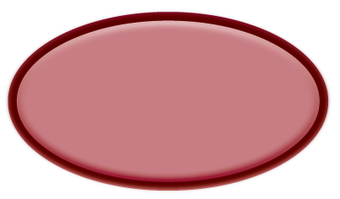
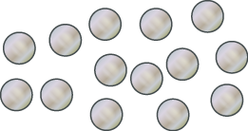
Effects of GLP-1 on the β-cell in healthy subjects
Insulin release
24
Adapted from a review article on the actions and effects of incretin hormones. Adapted from Drucker DJ. Cell Metab. 2006; 3:153-6.
Notes:
24

Slide 25
Effect of GLP-1 on Insulin Response to Glucose in Patients with T2DM
Can DPP4 inhibitors increase
insulin secretion capacity?
Short-term effect
Increased
glucose
sensitivity
Insulin Secretory Response
Glucose-dependent
stimulation of
insulin secretion
Insulin
capacity
Insulin
capacity
ED₅₀
ED₅₀
No danger of
hypoglycaemia
Glucose sensitivity
4.5
5.0
5.5
6.0
6.5
7.0
Glucose Concentration (mmol/L)
ED₅₀=effective dose at 50%; GLP-1=glucagon-like peptide-1; T2DM=type 2 diabetes mellitus.
Holst JJ. Diabetes Metab Res Rev. 2002;18:430–441;
Zander M, et al. Lancet. 2002;359:824–30.
25
Notes:
25

Slide 26


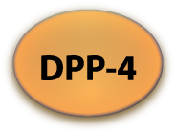

GLP-1 is cleaved and inactivated by DPP-4
26
Adapted from a review article on the actions and effects of incretin hormones. Drucker DJ et al. Diabetes Care 2007;30:1335-43.
Notes:
26

Slide 27
Vildagliptin: Change in Body Weight at 52 Weeks
Change from BL to Wk 52 Mean BL ~ 85 kg
Between-treatment difference
Change in body weight over 52 weeks†
N=
386
393
1.36
1.2
0.8
Adjusted Mean Change in body weight (kg)
0.4
0.08
0.0
-0.4
-0.8
-1.2
-1.6
-1.28
*
Vilda 50 mg bid + Met
Vilda 50 mg bid + Met
Glic up to 320 mg + Met
Glic up to 320 mg + Met
Per protocol (PP) population;
* p<0.001 Vilda vs Glic, 95% CI (-1.77, -0.79)
Glic= gliclazide; Met= metformin; Vilda= vildagliptin; BL= baseline; EP= end point
Adjusted mean change from BL to EP and p-value were from an ANCOVA model containing terms for treatment, baseline and pooled center.
Filozof et al Diabetes Medicine 2010 (27) 318-326.
†LAF237A2338, PT- Table 14.2-5.1b (Graph not in publication).
Notes:
27

Slide 28
Mr PB
3 years later:
126 kg
HbA1C=8.3%
Refer to Endocrinologist
Complications:
  microalbuminuria ACR: 6.6 mg/mmol
  Early peripheral neuropathy

Slide 30
Need reduction of 1.3%
Exenatide
Excellent response!
HbA1C: 6.8%
W=110 kg

Slide 31

GLP-1 in type 2 diabetes
Insulin release
Adapted from a review article on the actions and effects of incretin hormones and from a study that compared the incretin effect (the GLP-1 response) in 54 patients with type 2 diabetes (T2D), 33 matched controls with normal glucose tolerance (NGT) and 15 unmatched subjects with impaired glucose tolerance (IGT); the study found that, compared to NGT group, the incretin response was significantly reduced (p<0.05) in the T2D group and somewhat decreased in the IGT group. Adapted from Drucker DJ. Cell Metab 2006;3:153-6 Toft-Nielsen MB et al J Clin Endocrinol Metab 2001; 86: 3717-23.
31
Notes:
31

Slide 32








Exenatide is not inactivated by DPP-4
32
Adapted from review articles on the effects of exenatide and GLP-1 based treatment and from the Byetta Product Information. Schmitz O. J Clin Endocrinol Metab 2008;93:375-377; Nielsen LL et al. Reg Pept 2004;117:77-88; Baggio LL, Drucker DJ. Gastroenterology 2007;132:2131-57; Byetta Product Information.
Notes:
DISCUSSION
Exenatide is not inactivated by DPP-4 and has a much longer plasma half-life than GLP-1^{1,2}
Exenatide is the synthetic version of exendin-4¹
Exendin-4 and GLP-1 have equivalent binding affinities for the GLP-1 receptor in in vitro assays, and both peptides stimulate the receptor equipotently¹
REFERENCES
1. Nielsen LL et al. Regul Pept. 2004;117:77-88
2. Baggio LL et al. Gastroenterology. 2007;132:2131-2157
32

Slide 33
Mr PB
2 years later:
Severe pneumonia, with bronchospasm
Prednisolone 25 mg, 10 days
Marked hyperglycaemia
HbA1C=11.1%

Slide 35
Mr PB
Pretorius Principle: What reduction?
Insulin!
Lantus
HbA1C: 8.3%

Slide 36
Case Study 2:
Mr AC

Slide 37
Mr AC
36 yr old
T2 DM: 3 years
Strong family history of DM and IHD
No complications
Metformin, Lantus
HbA1C=11.1%
W=92kg

Slide 38
Mr AC
HBGM:
  BB: 6.2-7.7 mmol/L
  AB: 12-18.3 mmol/L
  BL: 8.2-11.1 mmol/L
  BD: 7.8-12 mmol/L
  AD: 14-18.6 mmol/
Add short-acting insulin

Slide 39
Mimicking nature: basal–bolus insulin concept
Endogenous insulin
Bolus insulin
Fasting
period
Basal insulin
Insulin effect
HS
Breakfast
Lunch
Supper
Adapted with permission from: McCall A. In: Leahy J, Cefalu W, eds. Insulin Therapy. New York, NY: Marcel Dekker Inc; 2002:193
Notes:
39
Mimicking nature: basal–bolus insulin concept
The ‘basal–bolus insulin’ approach combines long- and short-acting insulin or analogue preparations to emulate as closely as possible physiological insulin secretory patterns. Ideally, the basal insulin is supplied as an injection once a day, which is then supplemented at times when the blood glucose is expected to peak (e.g. meal times). In this way, basal–bolus insulin therapy is designed to deliver the correct amount of insulin as and when needed, thereby attaining near-normal glycaemia day and night. By necessity, this requires multiple injections and frequent self-monitoring of blood glucose.
Diabetes education is a core element of basal–bolus insulin therapy and includes specific instructions on how to regulate nutritional intake, techniques such as ‘carbohydrate counting’ to help determine optimal insulin dosages and related meal-planning strategies. This approach also reduces the risk of hypoglycaemia, especially in those with erratic schedules or more labile diabetes due to greater insulin deficiency.

Slide 40
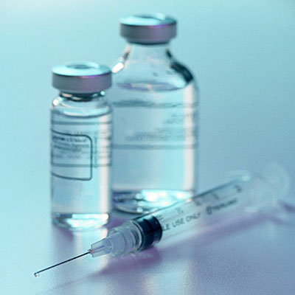
Weight Gain
Weight loss precedes the diagnosis of Type II DM
Due to:
  Glucosuria
  Energy used to over produce glucose
Thus weight gain in improved control due to
  Decrease in glucosuria
  Decrease basal metabolic rate
  Unchanged dietary intake

Slide 41

To counteract weight gain start insulin before marked glucosuria
5mmol/L decrease in fasting glucose and decrease HbA1C of 2,5% from fasting glucose of 15mmol/L is associated with 5kg weight gain during 1 year.
Predictors of weight gain:
  Initial glycemia
  Response to treatment

Slide 42
Mr AC
2 years later: 110 kg
HbA1C: 8.1 %

Slide 43
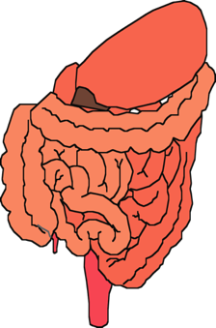

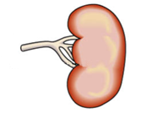

SGLT-2 inhibitors
pancreatic
insulin
secretion
incretin
effect
Increased glucose
reabsorption
pancreatic
glucagon
secretion
gut
carbohydrate
delivery &
absorption
-
HYPERGLYCAEMIA
-
+
peripheral
glucose
uptake
hepatic
glucose
production
Adapted from: Bailey CJ. Trends Pharmacol Sci 2011;32:63–71.

Slide 44

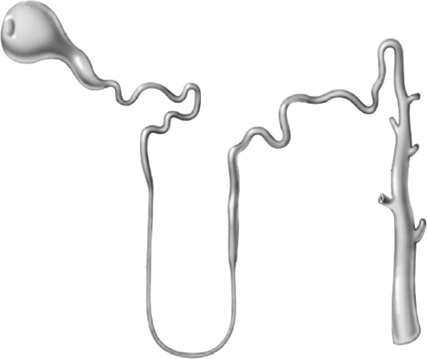

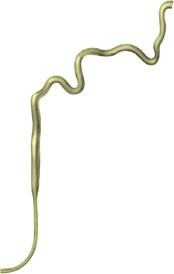



What do SGLT-2 inhibitors do?
Glucose
When blood glucose increases above a certain level, the capacity of the transporters is exceeded, resulting in glucosuria
SGLT-2
~90%
SGLT-1
~10%
Glucosuria
Adapted from: Bailey CJ. Trends Pharmacol Sci 2011;32:63–71.
Notes:
When plasma glucose concentrations exceed 10-11 mmol/L (180-200 mg/dL), glucose starts to escape in the urine.

Slide 45
What do SGLT-2 inhibitors do?
Glucose
SGLT-2 inhibitors reduce glucose reabsorption in the proximal tubule, leading to glucosuria with low risk of hypoglycaemia
SGLT-2
SGLT-2
inhibitor
SGLT-1
Glucosuria
Loss of calories
Adapted from: Bailey CJ. Trends Pharmacol Sci 2011;32:63–71.

Slide 46


EMPA-REG

Slide 47
EMPA-REG

Slide 48
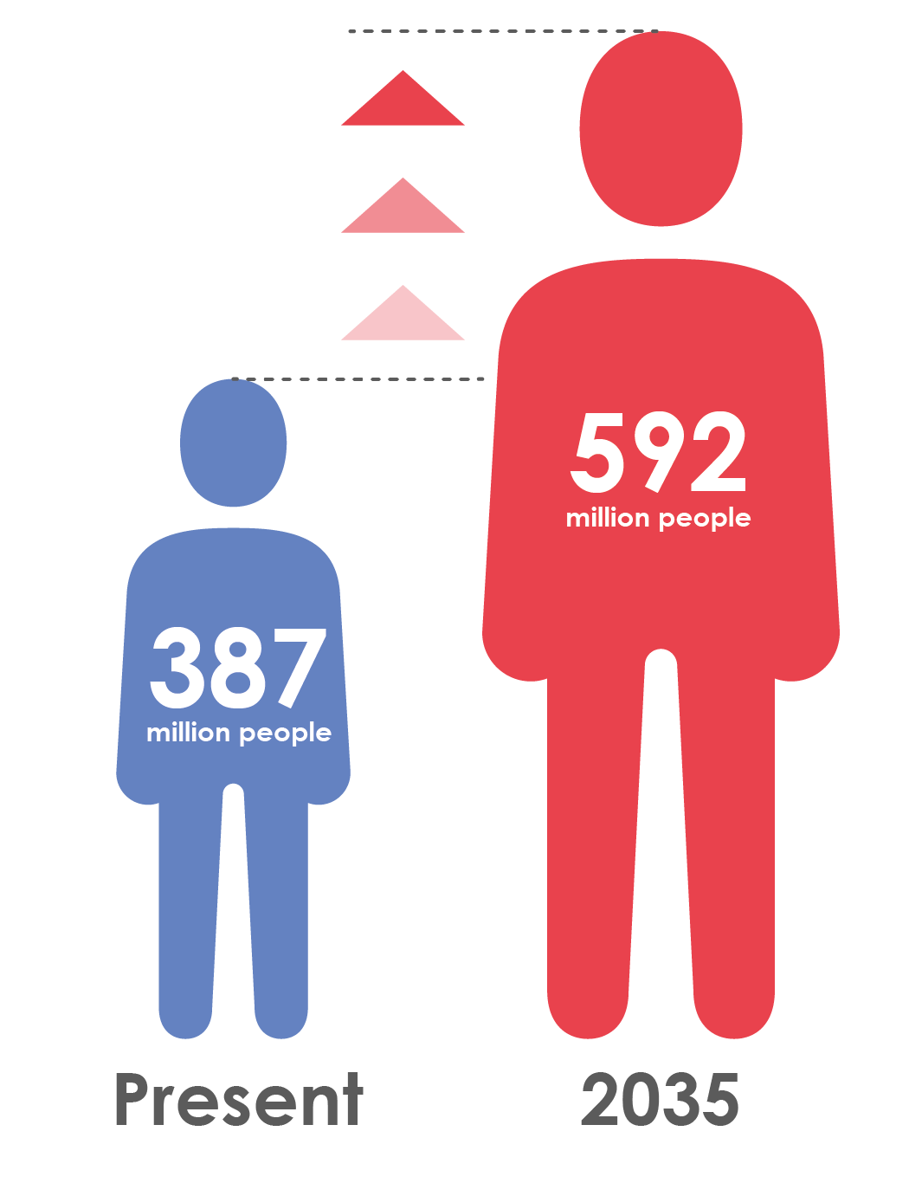
Type 2 diabetes is increasingly prevalent
Globally, 387 million people are living with diabetes¹
At least 68% of people >65 years with diabetes die of heart disease²
Mortality risk associated with diabetes (n=820,900)³
This will rise to 592 million by 2035¹

Slide 49
Diabetes is associated with significant loss of life years
Men
Women
7
6
5
4
3
2
1
0
Non-vascular deaths
Vascular deaths
7
6
5
4
3
2
1
0
Years of life lost
0
40
50
60
70
80
90
0
40
50
60
70
80
90
Age (years)
Age (years)
On average, a 50-year-old individual with diabetes and no history of vascular disease will die 6 years earlier compared to someone without diabetes
.

Slide 50
Meta-analysis of intensive glucose control in T2DM: major CV events including heart failure
 | Number of events
 | More intensive | Less intensive | Difference in HbA1c (%) |  | HR (95% CI)
Stroke | 378 | 370 | -0.88 |  | 0.96 (0.83, 1.10)
Myocardial infarction | 730 | 745 | -0.88 |  | 0.85 (0.76, 0.94)
Hospitalisation for or death from heart failure | 459 | 446 | -0.88 |  | 1.00 (0.86, 1.16)
Favours more intensive
Favours less intensive
Meta-analysis of 27,049 participants and 2370 major vascular events from:
  ADVANCE
  UKPDS
  ACCORD
  VADT

Slide 51
Meta-analysis of intensive glucose control in T2DM: mortality
 | Number of events
 | More intensive | Less intensive | Difference in HbA1c (%) |  | HR (95% CI)
All-cause mortality | 980 | 884 | -0.88 |  | 1.04 (0.90,1.20)
CV death | 497 | 441 | -0.88 |  | 1.10 (0.84,1.42)
Non-CV death | 476 | 432 | -0.88 |  | 1.02 (0.89,1.18)
Favours more intensive
Favours less intensive
Meta-analysis of 27,049 participants and 2370 major vascular events from
  ADVANCE
  UKPDS
  ACCORD
  VADT

Slide 52
Empagliflozin
Empagliflozin is a highly selective inhibitor of the sodium glucose cotransporter 2 (SGLT2) in the kidney
Glucose reduction occurs by reducing renal glucose reabsorption and thus increasing urinary glucose excretion
In patients with type 2 diabetes, empagliflozin leads to¹:
  Significant reductions in HbA1c
  Weight loss
  Reductions in blood pressure without increases in heart rate

Slide 53
Empagliflozin modulates several factors related to CV risk
Other
⬇BP
⬇Arterial stiffness
⬇Albuminuria
⬇Uric acid
⬇Glucose
⬇Insulin
⬇Sympathetic nervous system activity
↑LDL-C
↑HDL-C
⬇Triglycerides
⬇Weight
⬇Visceral adiposity
⬇Oxidative stress

Slide 54
Trial design
Placebo
(n=2333)
Screening
(n=11531)
Randomised and treated
(n=7020)
Empagliflozin 10 mg
(n=2345)
Empagliflozin 25 mg
(n=2342)
Study medication was given in addition to standard of care
  Glucose-lowering therapy was to remain unchanged for first 12 weeks
Treatment assignment double masked
The trial was to continue until at least 691 patients experienced an adjudicated primary outcome event

Slide 55
Key inclusion and exclusion criteria
Key inclusion criteria
  Adults with type 2 diabetes
  BMI ≤45 kg/m²
  HbA1c 7–10%*
  Established cardiovascular disease
    Prior myocardial infarction, coronary artery disease, stroke, unstable angina or occlusive peripheral arterial disease
Key exclusion criteria
  eGFR <30 mL/min/1.73m² (MDRD)

Slide 56
Pre-specified primary and key secondary outcomes
Primary outcome
  3-point MACE: Time to first occurrence of CV death, non-fatal MI or non-fatal stroke
Key secondary outcome
  4-point MACE: Time to first occurrence of CV death, non-fatal MI, non-fatal stroke or hospitalisation for unstable angina

Slide 57
Further pre-specified outcomes
CV death
Non-fatal MI
Non-fatal stroke
Hospitalisation for heart failure
All-cause mortality
All CV and neurological events were adjudicated by independent, masked, clinical event committees

Slide 58
Baseline characteristics
 | Placebo (n=2333) | Empagliflozin 10 mg (n=2345) | Empagliflozin 25 mg (n=2342)
Age, years | 63.2 (8.8) | 63.0 (8.6) | 63.2 (8.6)
Male | 1680 (72.0) | 1653 (70.5) | 1683 (71.9)
Region
Europe | 959 (41.1) | 966 (41.2) | 960 (41.0)
North America* | 462 (19.8) | 466 (19.9) | 466 (19.9)
Asia | 450 (19.3) | 447 (19.1) | 450 (19.2)
Latin America | 360 (15.4) | 359 (15.3) | 362 (15.5)
Africa | 102 (4.4) | 107 (4.6) | 104 (4.4)
Data are n (%) or mean (SD) in patients treated with ≥1 dose of study drug
Notes:
tlr-1245_0025final—01-1501. Table 15.1.4.1: 1 Demographic data − treated set.

Slide 59
Baseline characteristics: type 2 diabetes
Glucose-lowering medication*
Metformin | 1734 (74.3) | 1729 (73.7) | 1730 (73.9)
Sulphonylurea | 992 (42.5) | 985 (42.0) | 1029 (43.9)
Thiazolidinedione | 101 (4.3) | 96 (4.1) | 102 (4.4)
Insulin | 1135 (48.6) | 1132 (48.3) | 1120 (47.8)
Mean daily dose, U** | 65 (50.6) | 65 (47.9) | 66 (48.9)
 | Placebo (n=2333) | Empagliflozin 10 mg (n=2345) | Empagliflozin 25 mg (n=2342)
HbA1c, % | 8.08 (0.84) | 8.07 (0.86) | 8.06 (0.84)
Time since diagnosis of type 2 diabetes, years
≤5 | 423 (18.1) | 406 (17.3) | 434 (18.6)
>5 to 10 | 571 (24.5) | 585 (24.9) | 590 (25.2)
>10 | 1339 (57.4) | 1354 (57.7) | 1318 (56.3)
Data are n (%) or mean (SD) in patients treated with ≥1 dose of study drug
Notes:
Table 15.1.4.1: 1
Table 15.2.4.3.8: 5 but updated by MM (awaiting final PDF).

Slide 60
HbA1c
0
12
28
40
52
66
80
94
108
122
136
150
164
178
192
206
Placebo
2294
2272
2188
2133
2113
2063
2008
1967
1741
1456
1241
1109
962
705
420
151
Empagliflozin 10 mg
2296
2272
2218
2150
2155
2108
2072
2058
1805
1520
1297
1164
1006
749
488
170
Empagliflozin 25 mg
2296
2280
2212
2152
2150
2115
2080
2044
1842
1540
1327
1190
1043
795
498
195
Notes:
1245_0025final--01-1502--study-report-body. Table 15.2.4.3.1.3: 1 HbA1c (%) change from baseline MMRM results over time − FAS (OC−AD)

Slide 61
Weight
Placebo
Empagliflozin 10 mg
Empagliflozin 25 mg
0
12
28
52
108
164
220
Placebo
2285
1915
2215
2138
1598
1239
425
Empagliflozin 10 mg
2290
1893
2238
2174
1673
1298
483
Empagliflozin 25 mg
2283
1891
2226
2178
1678
1335
489
Notes:
1245_0025final--01-1502--study-report-body. Table 15.2.4.3.3.3: 1 Weight (kg) change from baseline MMRM results over time − treated set (OC−AD)

Slide 62
Waist circumference
Placebo
Empagliflozin 10 mg
Empagliflozin 25 mg
0
12
28
52
108
164
220
Placebo
2259
1869
2183
2110
1562
1220
418
Empagliflozin 10 mg
2272
1836
2219
2155
1644
1285
475
Empagliflozin 25 mg
2273
1857
2209
2157
1648
1329
486
Notes:
1245_0025final--01-1502--study-report-body. Table 15.2.4.3.4.3: 1 Waist circumference (cm) change from baseline MMRM results over time − treated set (OC−AD)

Slide 63
Systolic blood pressure
Placebo
Empagliflozin 25 mg
Empagliflozin 10 mg
0
16
28
40
52
66
80
94
108
122
136
150
164
178
192
206
Placebo
2322
2235
2203
2161
2133
2073
2024
1974
1771
1492
1274
1126
981
735
450
171
Empagliflozin 10 mg
2322
2250
2235
2193
2174
2125
2095
2072
1853
1556
1327
1189
1034
790
518
199
Empagliflozin 25 mg
2323
2247
2221
2197
2169
2129
2102
2066
1878
1571
1351
1212
1070
842
528
216
Notes:
1245_0025final--01-1502--study-report-body. Table 15.2.4.3.5.3: 1 SBP (mmHg) change from baseline MMRM results over time − treated set (OC−AD)

Slide 64
Diastolic blood pressure
Placebo
Empagliflozin 25 mg
Empagliflozin 10 mg
0
16
28
40
52
66
80
94
108
122
136
150
164
178
192
206
Placebo
2322
2235
2203
2161
2133
2073
2024
1974
1771
1492
1274
1126
981
735
450
171
Empagliflozin 10 mg
2322
2250
2235
2193
2174
2125
2095
2072
1853
1556
1327
1189
1034
790
518
199
Empagliflozin 25 mg
2323
2247
2221
2197
2169
2129
2102
2066
1878
1571
1351
1212
1070
842
528
216
Notes:
1245_0025final--01-1502--study-report-body. Table 15.2.4.3.6.3: 1 DBP (mmHg) change from baseline MMRM results over time − treated set (OC−AD)

Slide 65
Low-density lipoprotein cholesterol
Placebo
Empagliflozin 25 mg
Empagliflozin 10 mg
4
0
28
52
80
108
136
164
192
Placebo
2297
2273
2179
2104
2006
1932
1419
1086
694
Empagliflozin 10 mg
2294
2269
2205
2143
2072
1998
1474
1133
740
Empagliflozin 25 mg
2287
2256
2188
2132
2060
2020
1503
1169
779
Notes:
1245_0025final--01-1503--study-report-body (1). Table 15.3.2.4.3.3: 1 LDL cholesterol (mg/dL) change from baseline MMRM results over time − treated set (OC−AD)

Slide 66
High-density lipoprotein cholesterol
Empagliflozin 25 mg
Empagliflozin 10 mg
Placebo
4
0
28
52
80
108
136
164
192
Placebo
2297
2273
2181
2104
2007
1932
1419
1087
694
Empagliflozin 10 mg
2295
2270
2209
2144
2074
2001
1475
1134
741
Empagliflozin 25 mg
2289
2259
2191
2135
2064
2022
1507
1170
779
Notes:
1245_0025final--01-1503--study-report-body (1). Table 15.3.2.4.2.3: 1 HDL cholesterol (mg/dL) change from baseline MMRM results over time − treated set (OC−AD)

Slide 67
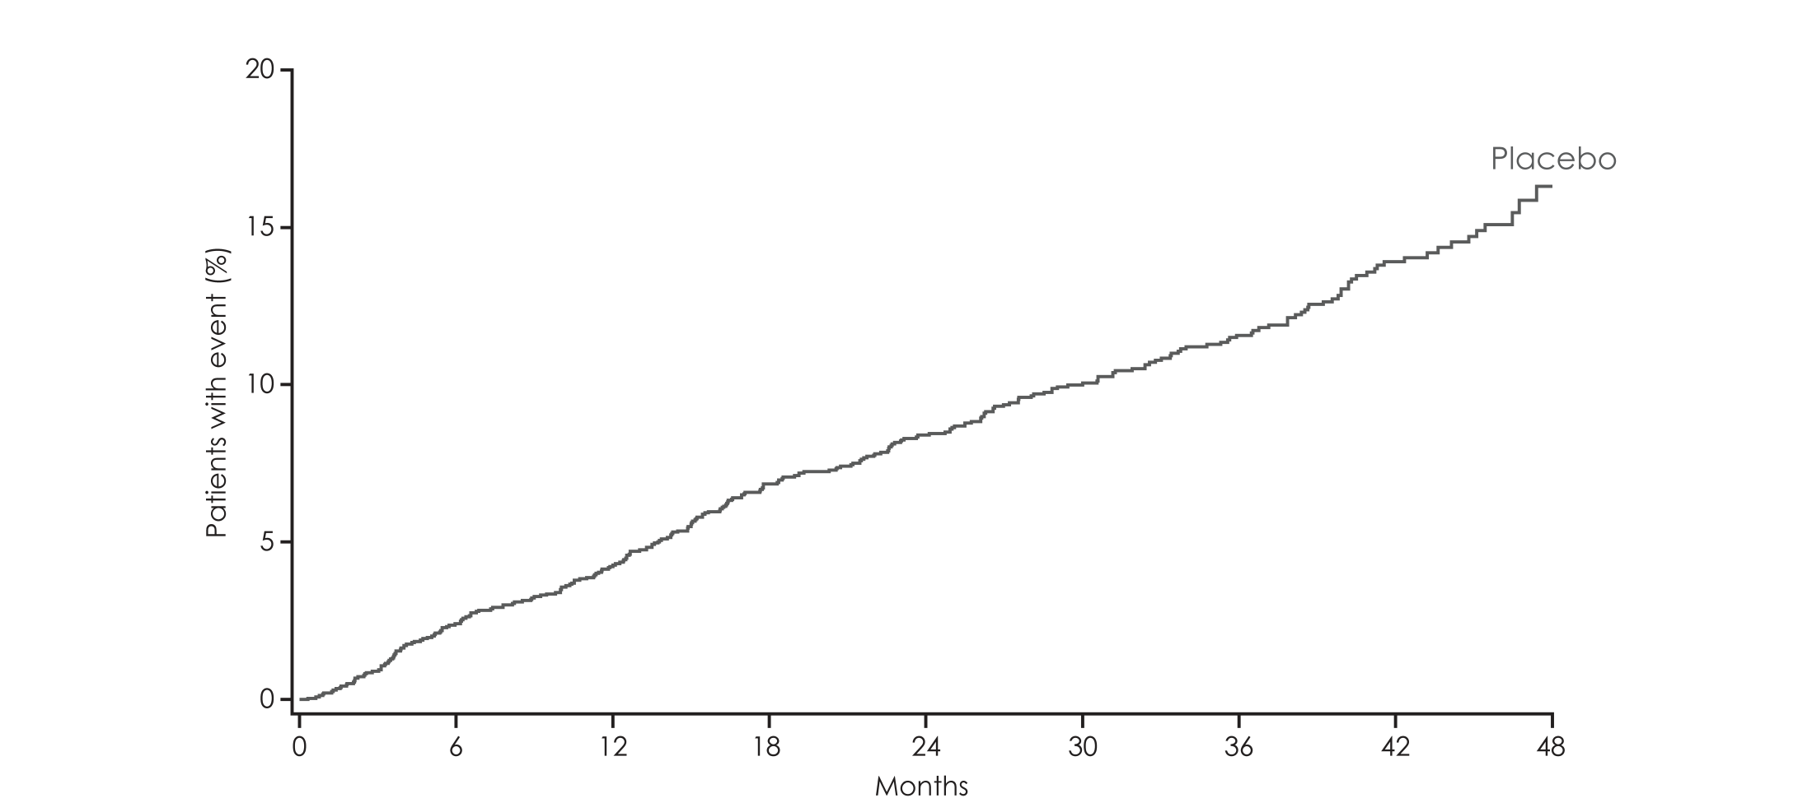
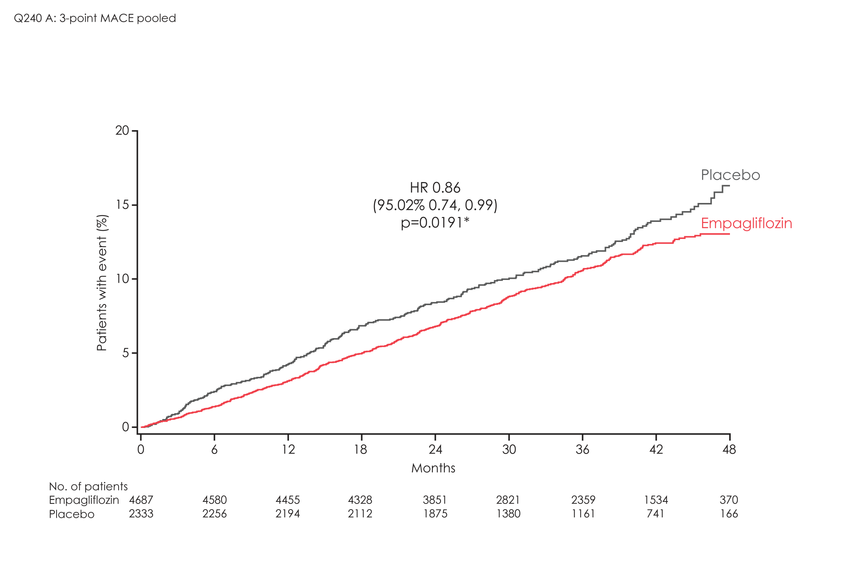
Primary outcome:
3-point MACE
HR 0.86
(95.02% CI 0.74, 0.99)
p=0.0382*

Slide 68
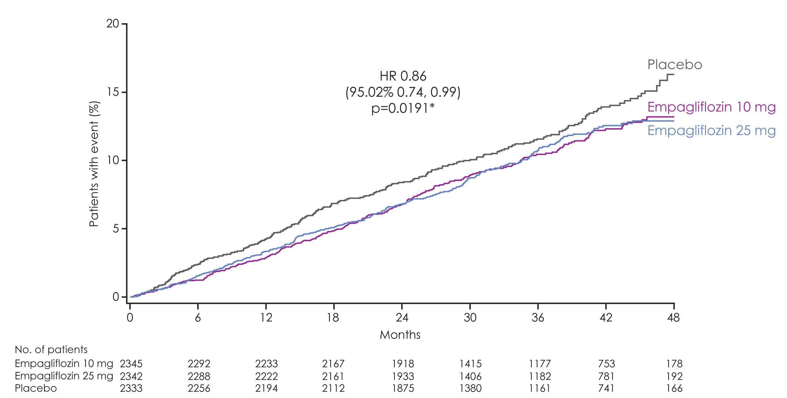
3-point MACE
Empagliflozin 10 mg
HR 0.85
(95% CI 0.72, 1.01)
p=0.0668
Empagliflozin 25 mg
HR 0.86
(95% CI 0.73, 1.02)

Slide 69
3-point MACE: sensitivity analyses
On-treatment analysis**
 |  | 407/4607 | 227/2308 | 0.87 | (0.74, 1.02) |  | 0.0839
Per protocol analysis***
 |  | 487/4654 | 278/2316 | 0.86 | (0.75, 1.00) |  | 0.0519
Patients with event/ analysed
 | Empagliflozin |  | Placebo | HR | (95% CI) |  | p-value
Intent-to-treat population
 |  | 490/4687 | 282/2333 | 0.86 | (0.74, 0.99)* |  | 0.0382
Favours empagliflozin
Favours placebo
Notes:
ITT: Table 15.2.1.1: 2
OS: Table 15.2.1.2: 1
PPS: Table 15.2.1.2: 3

Slide 70
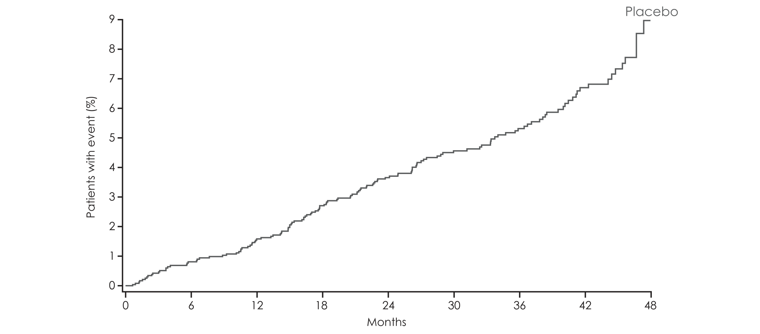
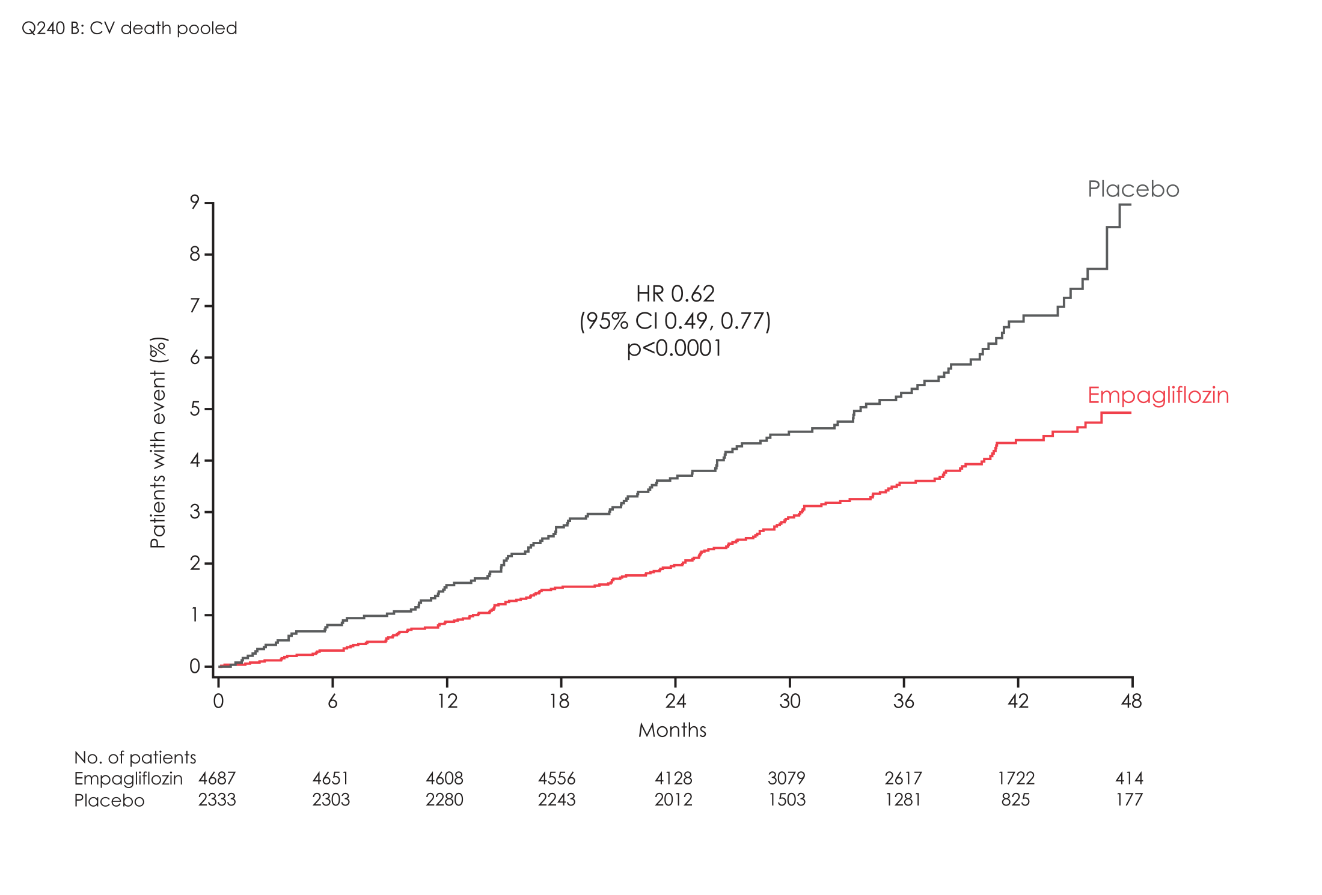
CV death
HR 0.62
(95% CI 0.49, 0.77)
p<0.0001

Slide 71
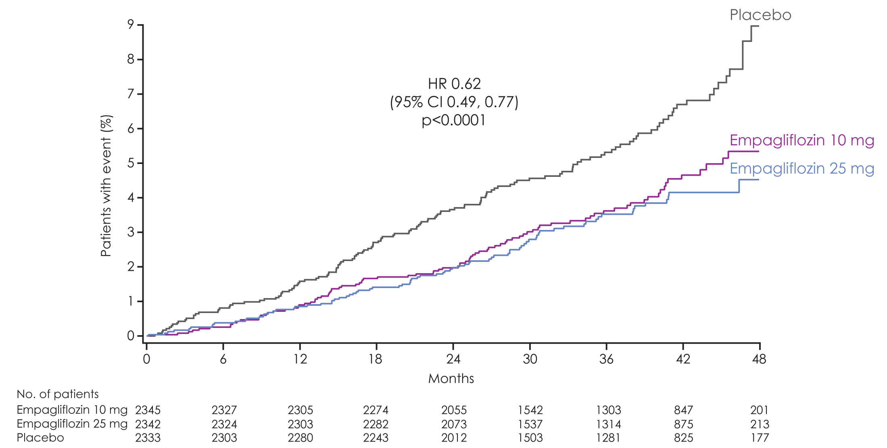
CV death
Empagliflozin 10 mg
HR 0.65
(95% CI 0.50, 0.85)
p=0.0016
Empagliflozin 25 mg
HR 0.59
(95% CI 0.45, 0.77)

Slide 72
Fatal and non-fatal stroke
Patients with event/analysed
 | Empagliflozin |  | Placebo | HR | (95% CI) |  | p-value
Intent-to-treat population
 |  | 164/4687 | 69/2333 | 1.18 | (0.89, 1.56) |  | 0.2567
Numerical difference largely driven by events occurring >30 days after treatment stop
Favours
empagliflozin
Favours
placebo
On-treatment analysis*
 | 141/4607 | 66/2308 | 1.04 | (0.78, 1.40) |  | 0.7849
Favours
empagliflozin
Favours
placebo
Notes:
Table 15.2.1.1: 2
On-treatment per protocol analysis (OS): Table 15.2.4.1.3: 3
On-treatment set (up to treat. stop + 30 days/indiv. trial compl): Table 15.2.4.1.3: 5

Slide 73
3-point MACE and 4-point MACE
Patients with event/analysed
 | Empagliflozin |  | Placebo |  | HR | (95% CI) |  | p-value
3-point MACE |  | 490/4687 |  | 282/2333 | 0.86 | (0.74, 0.99)* |  | 0.0382
CV death |  | 172/4687 |  | 137/2333 | 0.62 | (0.49, 0.77) |  | <0.0001
Non-fatal MI |  | 213/4687 |  | 121/2333 | 0.87 | (0.70, 1.09) |  | 0.2189
Non-fatal stroke |  | 150/4687 |  | 60/2333 | 1.24 | (0.92, 1.67) |  | 0.1638
4-point MACE
Favours empagliflozin
Favours placebo
Notes:
Table 15.2.4.1.1: 1
Table 15.2.4.1.2: 1
Table 15.2.4.1.3: 1
Table 15.2.4.1.5: 1
Table 15.2.4.1.8: 1
Table 15.2.4.1.9: 1

Slide 74
CV death, MI and stroke
Patients with event/analysed
 | Empagliflozin |  | Placebo |  | HR | (95% CI) |  | p-value
3-point MACE |  | 490/4687 |  | 282/2333 | 0.86 | (0.74, 0.99)* |  | 0.0382
CV death |  | 172/4687 |  | 137/2333 | 0.62 | (0.49, 0.77) |  | <0.0001
Non-fatal MI |  | 213/4687 |  | 121/2333 | 0.87 | (0.70, 1.09) |  | 0.2189
Non-fatal stroke |  | 150/4687 |  | 60/2333 | 1.24 | (0.92, 1.67) |  | 0.1638
Favours empagliflozin
Favours placebo
Notes:
Table 15.2.4.1.1: 1
Table 15.2.4.1.2: 1
Table 15.2.4.1.3: 1
Table 15.2.4.1.5: 1
Table 15.2.4.1.8: 1
Table 15.2.4.1.9: 1

Slide 75
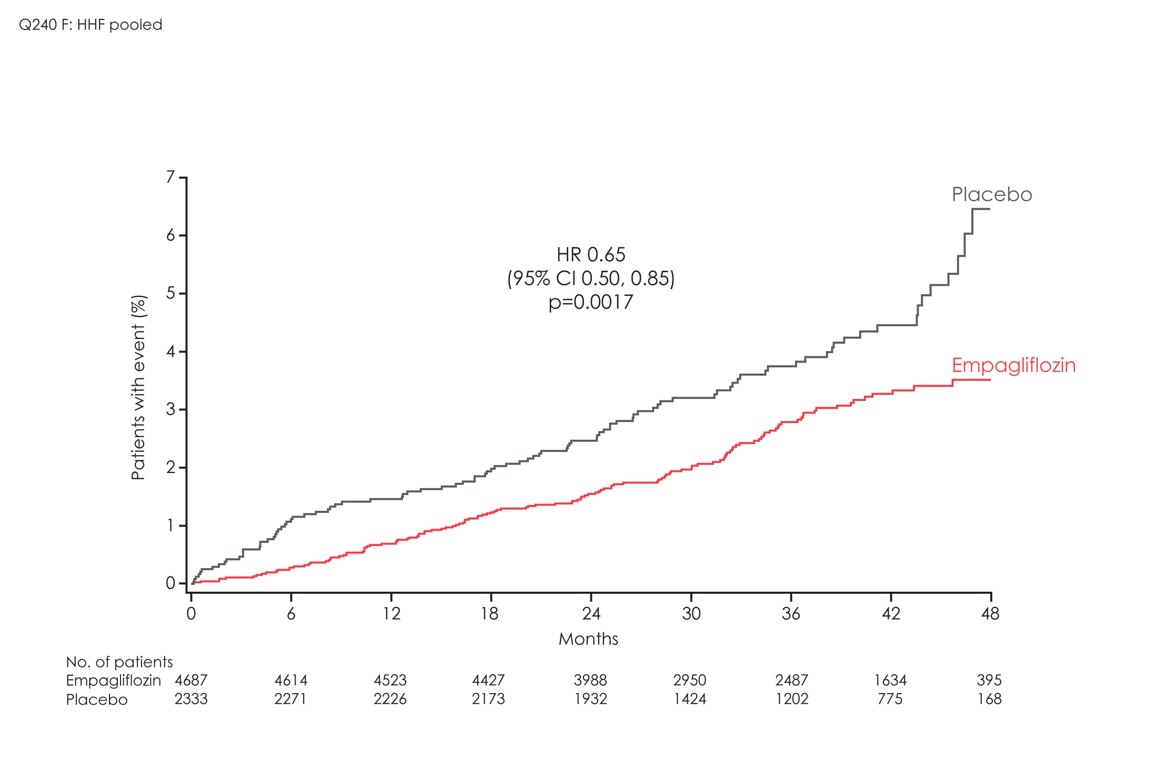
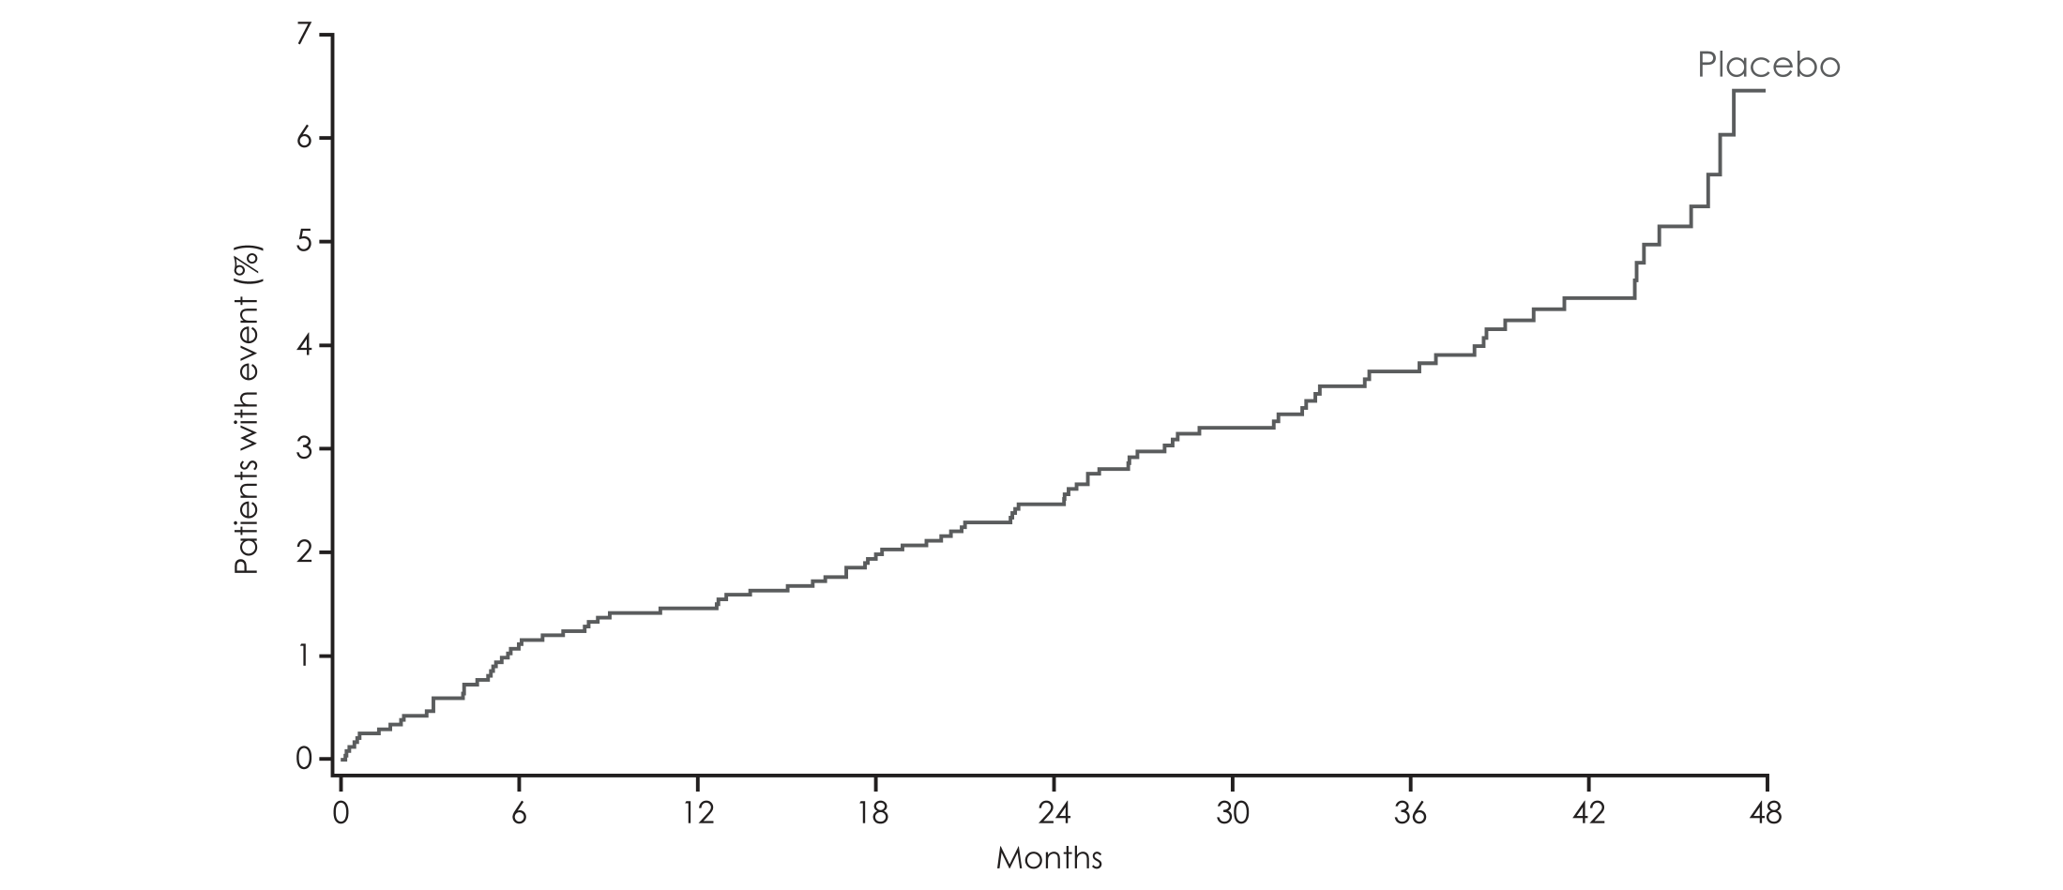
Hospitalisation for heart failure
HR 0.65
(95% CI 0.50, 0.85)
p=0.0017

Slide 76
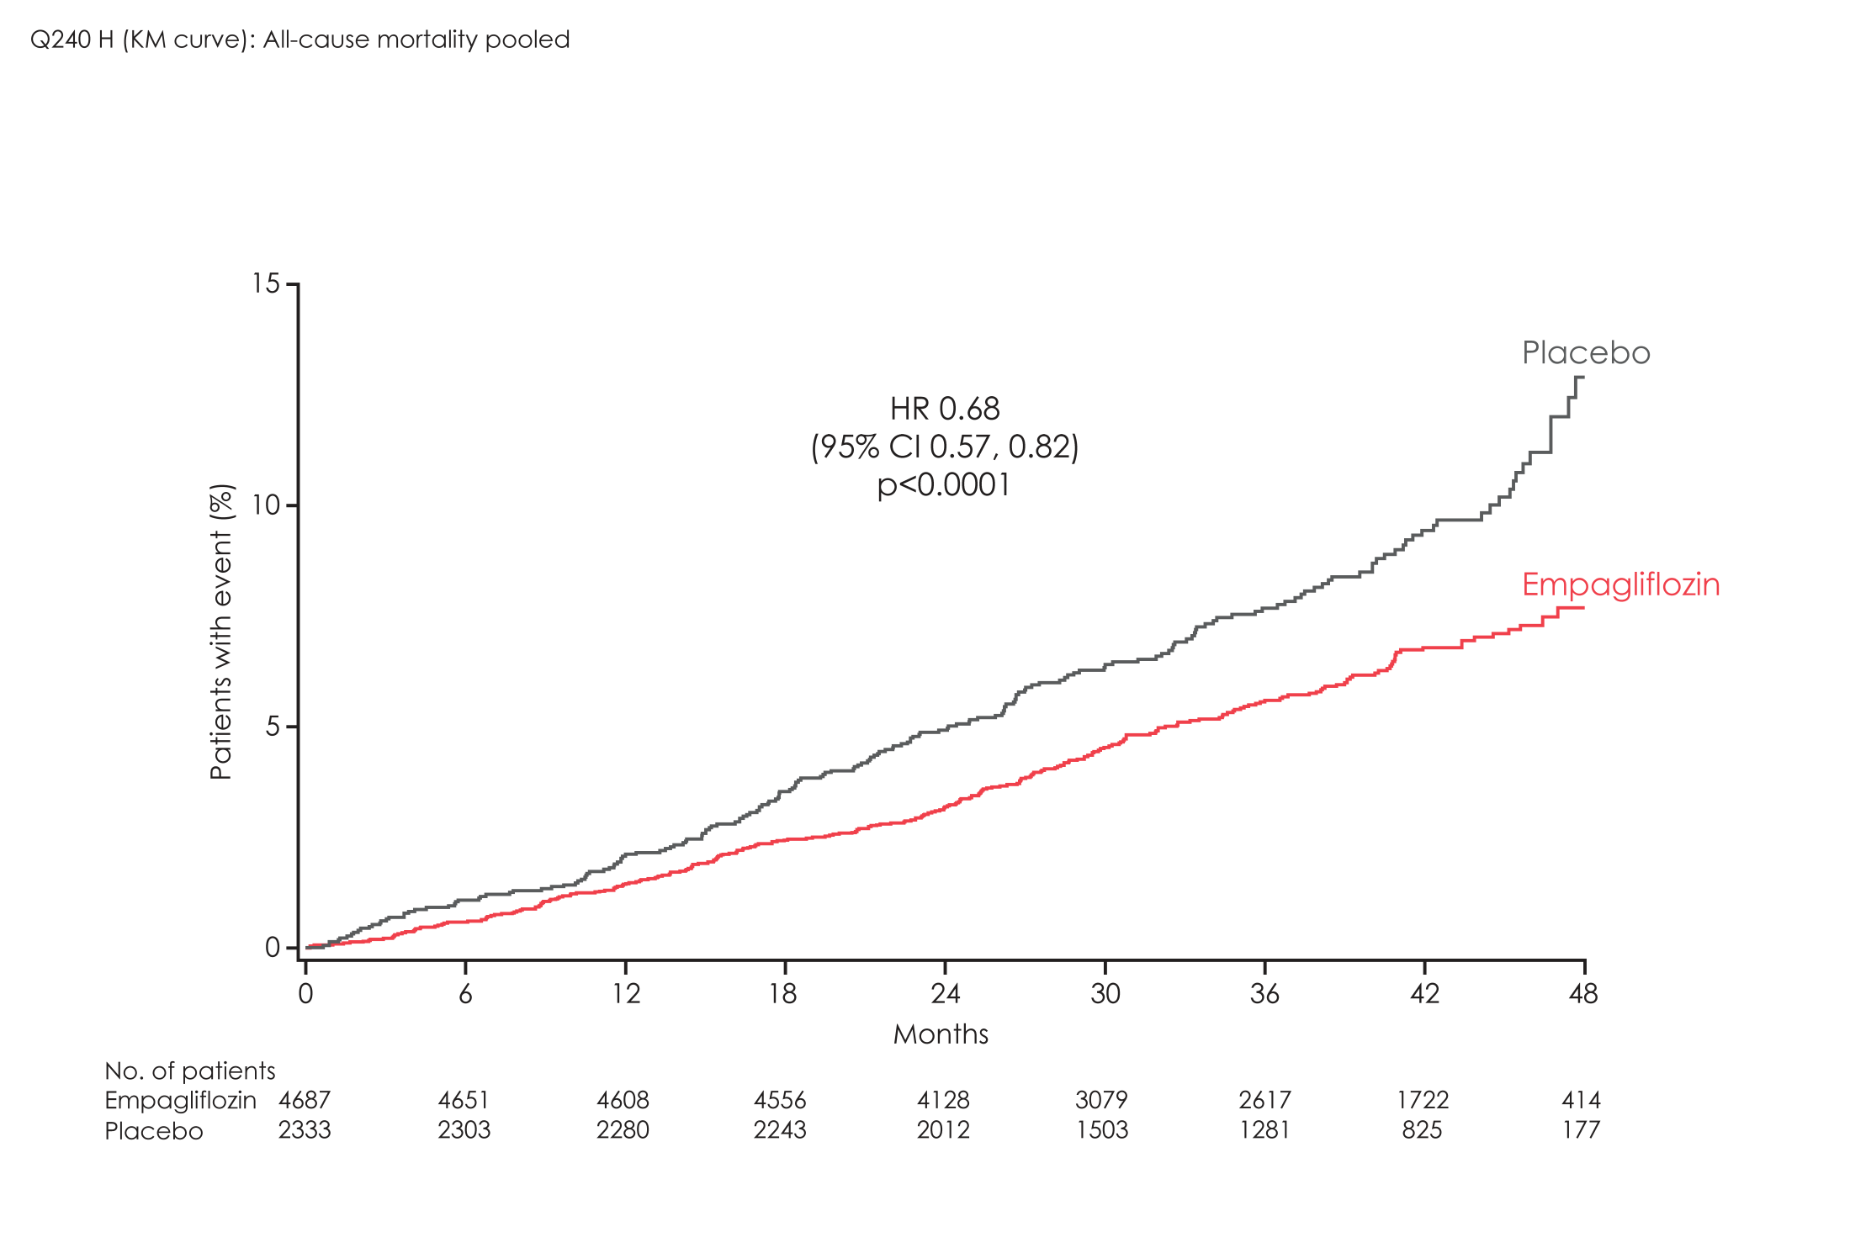
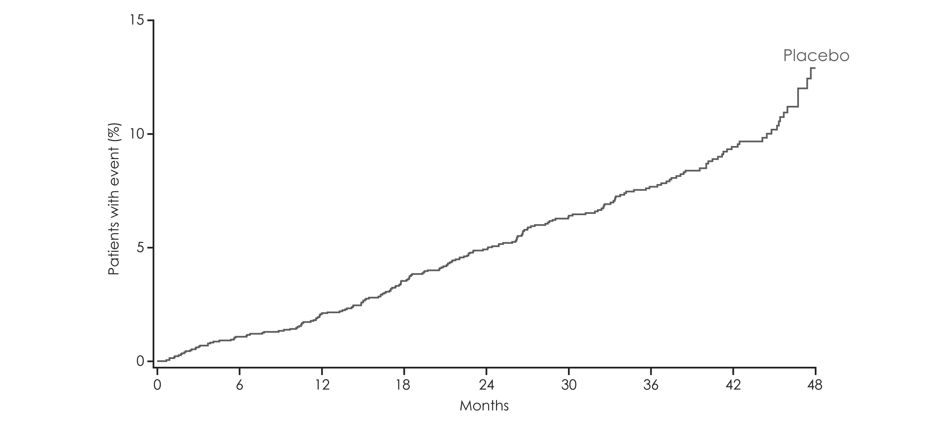
All-cause mortality
HR 0.68
(95% CI 0.57, 0.82)
p<0.0001

Slide 77
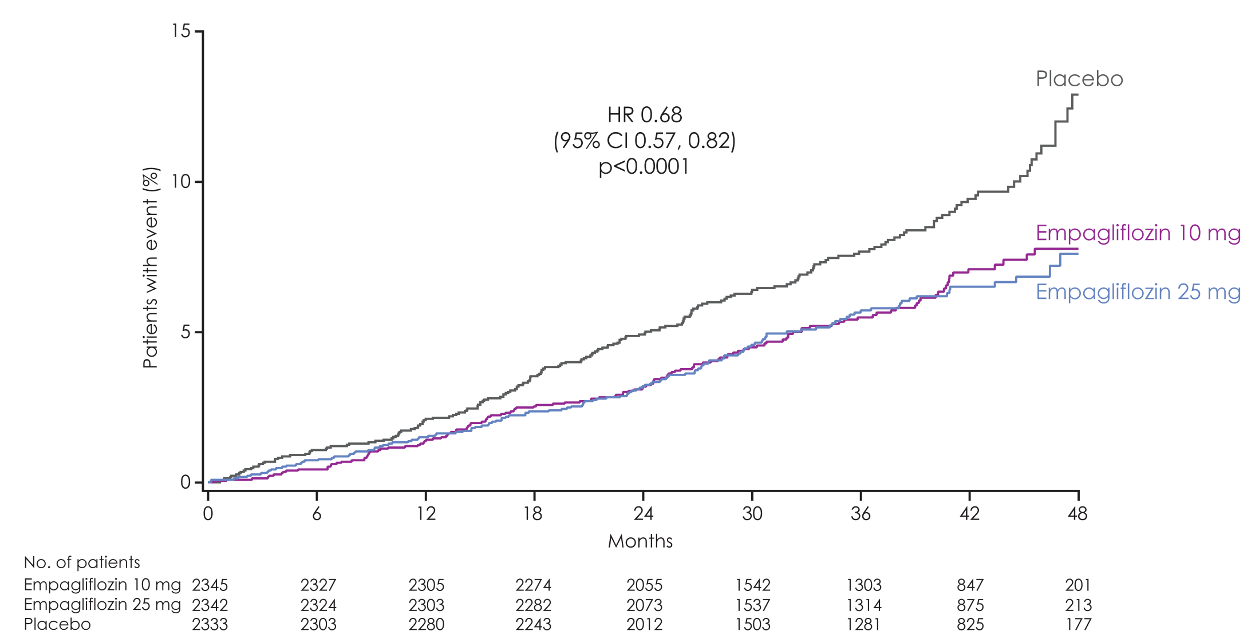
All-cause mortality
Empagliflozin 10 mg
HR 0.70
(95% CI 0.56, 0.87)
p=0.0013

Slide 78
Adverse events
 | Placebo (n=2333) |  | Empagliflozin 10 mg (n=2345) |  | Empagliflozin 25 mg (n=2342)
 | n (%) | Rate | n (%) | Rate | n (%) | Rate
One or more AEs | 2139 (91.7%) | 178.67 | 2112 (90.1%) | 150.34 | 2118 (90.4%) | 148.36
One or more drug-related* AEs | 549 (23.5%) | 11.33 | 666 (28.4%) | 14.15 | 643 (27.5%) | 13.38
One or more AEs leading to discontinuation | 453 (19.4%) | 8.26 | 416 (17.7%) | 7.28 | 397 (17.0%) | 6.89
One or more serious AEs | 988 (42.3%) | 22.34 | 876 (37.4%) | 18.20 | 913 (39.0%) | 19.39
Rate = per100 patient-years
Notes:
tlr-1245_0025final—01-1501. Table 15.1.4.1: 1 Demographic data − treated set.

Slide 79
Adverse events consistent with urinary tract infection
 | Placebo (n=2333) |  | Empagliflozin 10 mg (n=2345) |  | Empagliflozin 25 mg (n=2342)
 | n (%) | Rate | n (%) | Rate | n (%) | Rate
Events consistent with UTI | 423 (18.1%) | 8.21 | 426 (18.2%) | 8.02 | 416 (17.8%) | 7.75
Events leading to discontinuation | 10 (0.4%) | 0.17 | 22 (0.9%) | 0.37 | 19 (0.8%) | 0.31
By sex
Male | 158 (9.4%) | 3.96 | 180 (10.9%) | 4.49 | 170 (10.1%) | 4.09
Female | 265 (40.6%) | 22.81 | 246 (35.5%) | 18.83 | 246 (37.3%) | 20.38
Rate = per100 patient-years
Notes:
Total: Table 15.3.1.6: 1

Slide 80
EMPA-REG OUTCOME®: Summary
Empagliflozin reduced risk for 3-point MACE by 14%
Empagliflozin was associated with a reduction in HbA1c without an increase in hypoglycaemia, reductions in weight and blood pressure, and small increases in
LDL cholesterol and HDL cholesterol
Empagliflozin was associated with an increase in genital infections but was otherwise well tolerated

Slide 81
EMPA-REG OUTCOME®: Summary
Empagliflozin reduced hospitalisation for heart failure by 35%
Empagliflozin reduced CV death by 38%
Empagliflozin improved survival by reducing all-cause mortality by 32%

Slide 82
EMPA-REG OUTCOME®: Important features
Population studied
  A high CV risk population with modest hyperglycaemia on standard glucose-lowering and CV therapy
Follow-up and retention
  97.0% of patients completed the study and vital status was available for 99.2% of patients
Two doses of empagliflozin (10 mg and 25 mg) studied
  Similar magnitude of reduction with both doses for CV death, all-cause mortality and hospitalisation for heart failure

Slide 83
Number needed to treat (NNT) to prevent one death across landmark trials in patients with high CV risk
  Simvastatin¹
  for 5.4 years
Ramipril²
for 5 years
  Empagliflozin
  for 3 years
30
56
39
High CV risk
5% diabetes, 26% hypertension
High CV risk
38% diabetes, 46% hypertension
T2DM with high CV risk
92% hypertension
Pre-ACEi/ARB era
<29% statin
>80% ACEi/ARB
>75% statin
Pre-statin era
1994
2000
2015
Notes:
All cause death
Simva: 182 / 2221 (8,2%), placebo :256 / 2223 (11,5%) HR= 0,71[0,59;0,85]
pooled empa : 269 (5.7%)/2333, placebo : 194 (8.3%)/4687 HR= 0.68 (0.57,0.82)
Ramipril: 482 / 4645 (10,4%), placebo : 569 / 4652 (12,2%) HR=0,85[0,76;0,95]

Slide 84
EMPA-REG OUTCOME®:
Therapeutic considerations
Empagliflozin, as used in this trial, for 3 years in 1,000 patients with type 2 diabetes at high CV risk:
  25 lives saved (82 vs 57 deaths)
    22 fewer CV deaths (59 vs 37)
  14 fewer hospitalisations for heart failure (42 vs 28)
  53 additional genital infections (22 vs 75)

Slide 85

Quickfire

Slide 86

New Insulin and other Drugs
Dulaglutide: Once a week: AWARD-9
  50% less insulin requirements in combination with Lantus and metformin
Lixi/Lan: LIXINLAN-L
  Combination of lixisenatide and Lantus
  Improved post-prandial control, especially after breakfast
Faster Acting Aspart: ONSET-3
  1 hr post-prandial better, more hypos
SGLT-2 vs DPP IV:
  0.65% vs 0.58% reduction in HbA1C
  SGLT-2 better weight loss, more UTI
Inhaled Insulin: Dream Boat
Depot Insulin: U300 glargine, U200 degludec, U200 aspart

