Slide 1
HCV 2016
Alex Rodgers
Hepatologist
FMC

Slide 2
Disclosures
nil

Slide 3
Learning objectives/talk plan
Epidemiology and natural history of HCV infection in Australia
Who is at high risk for HCV and how to screen
How to evaluate patient with HCV
How to Treat
Long term follow up
GP resources

Slide 4
HCV epidemiology in Australia
Reduction in incidence since 1999
1999=14,000 new infections
2013=6,000 new infections
Prevalence
-230,000 (2014)
-13,000-22,000 aborigines / TSI
ie approx 4% indigenous australian, c/w 1% non indigenous
= approx 8% HCV burden
Increasing burden of disease (HCC, decompensation, liver-related death)
Notes:
Reduced incidence
-decreased IVDU
-IMPROVED HARM REDUCTION-NEEDLE EXCHANGE, OST)
INRCEASED PREVALENCE AND DISEASE BURDEN
-AGEING COHORT
SUBOPTIMAL TRATMENT AND UPTAKES

Slide 5
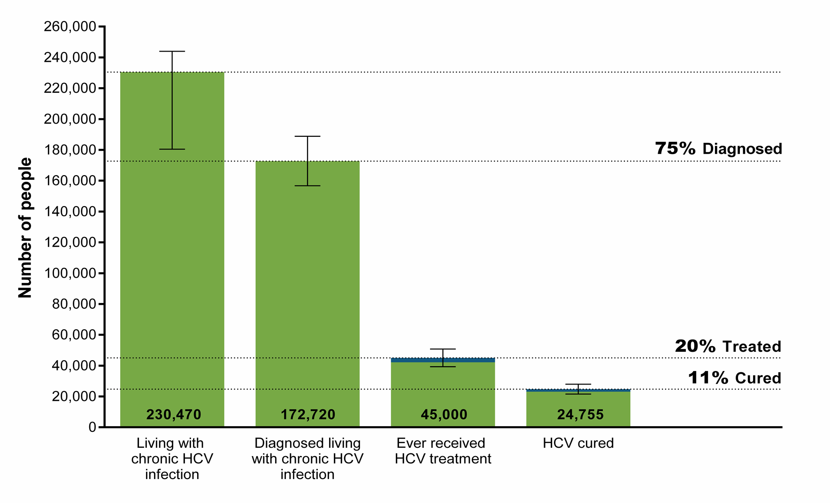
Hepatitis C Diagnosis and Care Cascade - 2014
Ref: Annual Surveillance Report of HIV, viral hepatitis, STIs; Kirby Institute
Notes:
230 K HCV POSITIVE=1.2% OF POPULATION
??75 % DIAGNOSED
20 % EVER TREATED
11 % CURED
POOR TREATMENT UPTAkE

Slide 6
Natural history of HCV
Notes:
Factors which may accelerate progression; alcohol, co-infection HBV, obesity/DM, MALE GENDER

Slide 7
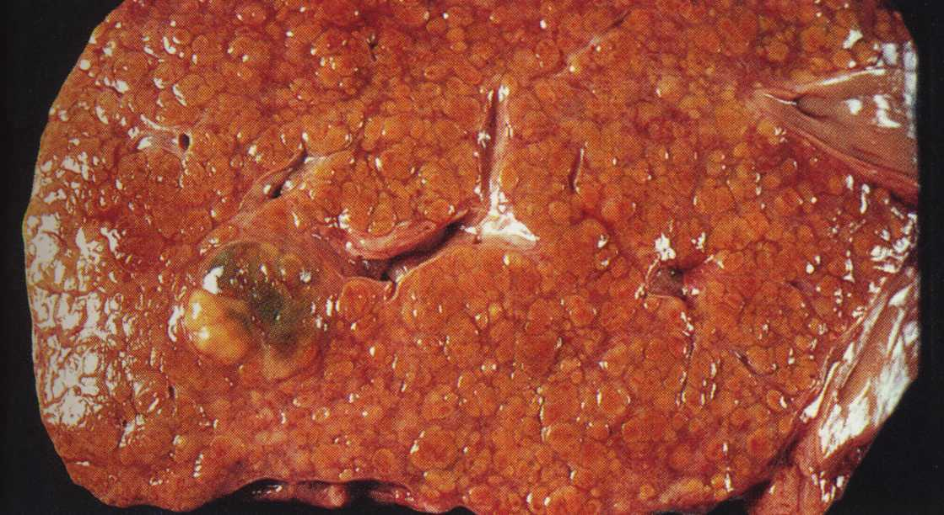
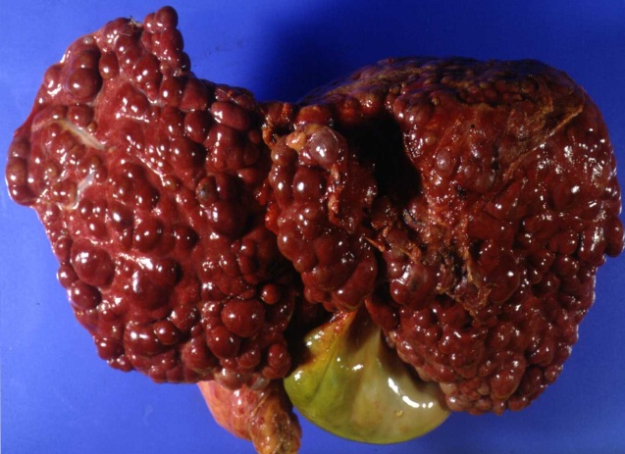
no progression
1/2
Acute hepC
~80%
Chronic hepC
1/4
cirrhosis in ~50 years
1/4
cirrhosis in ~20 years
Steatosis/NASH
Alcohol
Iron-overload
HBV/HIV/Schistosomiasis
Immunosuppression
Second hits
Age
Male sex
Genes
HCC
Liver failure: 5% per year
HCC-incidence: 1-3% per year
Notes:
1

Slide 8
Hepatitis C : Clinical features
infection
8 weeks
hepatitis
80% Asymptomatic
10 to 20 years
cirrhosis
liver failure
15 to 30 years
liver cancer

Slide 9
Poor treatment uptake
2,000 to 4,000 per year (1-2% of infected population)
Reasons
Toxic , ineffective therapy
Ineffective current models of care
6,000 new infections per year outstrips treatment
Rising prevalence of infection
Rising cirrhosis prevalence
Increase in cirrhosis from 14000 (2013) to 38000 (2030)
Notes:
Prevalence rises year on year despite decline in new infection/incidence

Slide 10
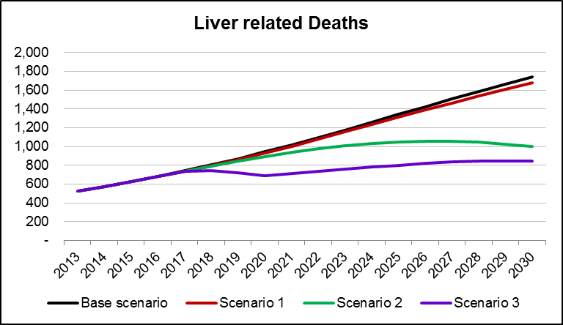
Base Scenario: No change
Scenario 1: Increase treatment efficacy alone (to 80-90%by 2016)
Scenario 2: Increase efficacy and increased treatment uptake (2550 to 13,500 by 2018) without treatment restriction
Scenario 3: Increased efficacy and increased treatment uptake with treatment limited to ≥F3 during 2015-2017
Ref: W. Sievert et al, JGH 2014; 29 (Suppl 1); 1-9
Notes:
Base(no change)-
Increase in LRD 500 to 1740
Tripling
Scenario 1-increase SVR only, no increase in treatment, unrestricted treatment= zero impact
Scen 2=increase SVR and increase treatment uptake (from 2500 to 13500 per year by 2018=5 fold increase per year), unrestricted-meaning impact-halve LRD’s
Scen 3= increase SVR, increase treatment uptake, restricted 2 years then unrestricted from 2018-most effective-halving LRDs, 30 % reduction in costs
Clear need both better therapy and better treatment uptake
Tonight looking forward to hear about one of the better high SVR treatment options and also how going to increase treatment numbers to achieve these outcomes
Figure 2. Projected burden of disease: liver-related deaths 2013-2030.
It will be necessary to increase BOTH treatment efficacy AND treatment uptake rates to reduce the projected burden of liver-related deaths due to HCV infection in Australia by 2030. Model inputs for scenarios. Scenario 1: increase SVR only with no increase in annual treated population and treatment eligibility not restricted by fibrosis stage. Scenario 2: increase SVR and annual treated population with no fibrosis-restricted eligibility. Scenario 3: increase SVR and annual treated population restricted to ≥ F3 (2015–2017) then unrestricted (all ≥ F0) from 2018 [6].

Slide 11
Who to screen
Abnormal liver function tests
Anyone !!
History of injection drug use
80 % of prevalent cases, 90 % incident cases
“treatment as prevention”
Custodial history
75 % of males, 60 % female prison populations
Recipients of blood/blood products/organ donations prior to 1990
5-10 % of prevalent cases
History of tattooing/piercing
Born in country with high prevalence
Via medical/dental procedures
Egypt, Pakistan, Mediterranean, Eastern Europe, Africa, Southern Asia
ATSI populations
8.3% of all HCV in Australia
Sexual partners of people with HCV
low risk of heterosexual sexual transmission
Higher risk in MSM
Higher risk sexual practices (high number of partners, unprotected anal sex, group sex)

Slide 12
How to screen
Notes:
Antibody test=past infection, not always current/active. Does not indicate immunity. Remains positive after clearance
RNA=active HCV
Problems of labelling active HCV

Slide 13
How to evaluate the HCV RNA positive patient
History
Other risk factors for advanced fibrosis
Physical examination
Investigations

Slide 14
Fibrosis Assessment
Does this patient have cirrhosis ?
Risks factors
Long duration of infection
Alcohol , NAFLD, cofactors
Signs of chronic liver disease
Lab findings-Platelet count, AST/ALT ratio, synthetic (INR, albumin) or excretory (bilirubin) dysfunction
APRI score
http://www.hepatitisc.uw.edu/page/clinical-calculators/apri
AST and platelet count
> 1.0 ? Cirrhosis, < 0.5 cirrhosis unlikely
Transient Elastography (Fibroscan)
> 12.5 consider cirrhosis

Slide 15
How to treat
DAAs available via PBS from March 1st
Can be prescribed by GP “in consultation” with a specialist
Use GESA-ALA GP checklist
http://www.gesa.org.au/files/editor_upload/File/PBS%20and%20MBS/Remote%20consultation%20form%20v4.pdf
> 90 % cure (SVR rate)
Minimal side effects
Fatigue
Headache
Nausea
Insomnia
Treatment selection influenced by
Genotype (viral load)
Presence/absence of cirrhosis
Prior therapy (interferon)
Renal function

Slide 16
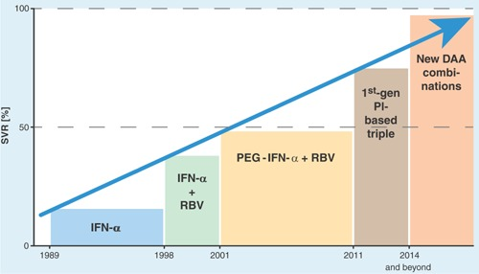

Slide 17
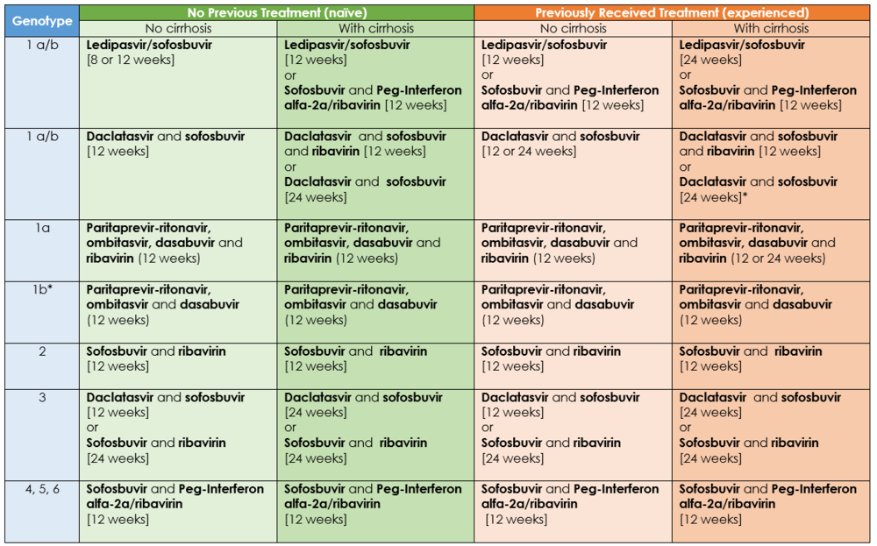

Slide 18
Regimen | Genotype | Duration | Select
Harvoni (sofosbuvir + ledipasvir) | 1 | 8 weeks (if VL < 6 million u/ml)
 | 1 | 12 weeks
Sofosbuvir + daclatasvir | 1 or 3 | 12 weeks
 | 1 or 3 | 24 weeks
Sofosbuvir + ribavirin | 2 | 12 weeks

Slide 19
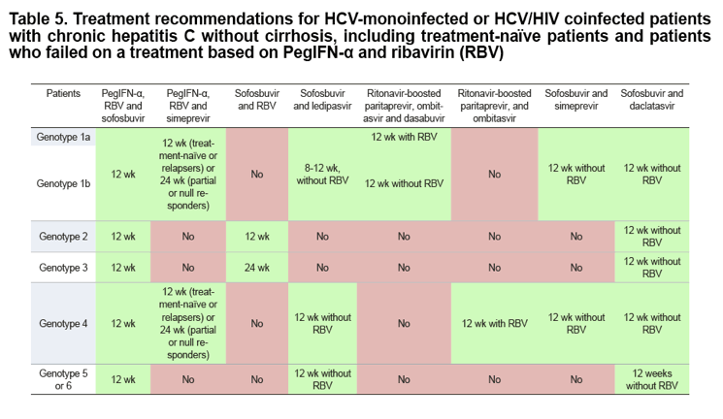

Slide 20
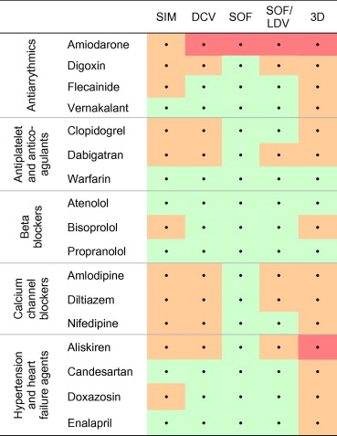
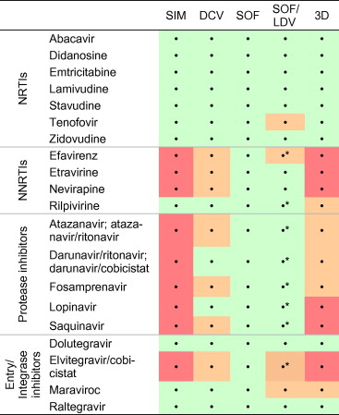
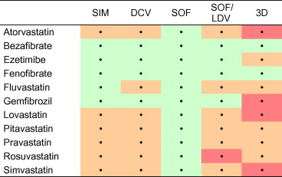

Slide 21
Assessment for Drug-Drug interactions
http://www.hep-druginteractions.org

Slide 23
On treatment monitoring
Week 0
CBP, ELU, LFTs, INR, HCV RNA level (quantitative)
Week 4
CBP, LFTs
End of Treatment
CBP, LFTs, HCV PCR (qualitative)
12 weeks post EOT
CBP, LFTs, HCV PCR (qualitative)
At each visit assess for
Medication adherance
treatment side effects
Drug-drug interactions

Slide 24
Ongoing monitoring of people after successful hepatitis C treatment outcome (SVR)
SVR, no cirrhosis, and normal LFT results (males, ALT < 30 U/L; females, ALT < U/L):
if cured do not require clinical follow-up for hepatitis C
SVR and abnormal LFT results (males, ALT ≥ 30 U/L; females, ALT ≥ 19 U/L):
if persistently abnormal LFT results require evaluation for other liver disease:
fasting glucose, insulin lipid levels,
ANA, ASMA, anti-LKM antibodies, total IgG AMA
caeruloplasmin, α-1-antitrypsin, iron studies
SVR, cirrhosis:
require long-term monitoring and should be enrolled in screening programs for
hepatocellular carcinoma
oesophageal varices
Osteoporosis
Vaccination (hepatitis A and B)
No SVR
Require specialist follow up

Slide 25
GP resources
Flinders Medical Centre Viral Hepatitis Centre
Fax No: 08 8204 3943
Rosalie.altus@sa.gov.au or Emma.tilley@sa.gov.au
GESA-ALA consensus statement
http://www.gesa.org.au/files/editor_upload/File/PBS%20and%20MBS/Hepatitis%20C%20virus%20infection%20a%20consensus%20statement%202016.pdf
GESA-ALA GP checklist and treatment summary
http://www.gesa.org.au/files/editor_upload/File/PBS%20and%20MBS/GP%20algorithm%20v3.pdf
GESA-ALA remote consultation form
http://www.gesa.org.au/files/editor_upload/File/PBS%20and%20MBS/Remote%20consultation%20form%20v4.pdf
APRI on line calculator
http://www.hepatitisc.uw.edu/page/clinical-calculators/apri
DDI manager
http://www.hep-druginteractions.org
NPS medicine wise learning; Hepatitis C in primary care module
http://learn.nps.org.au/pluginfile.php/185775/mod_scorm/content/3/nps.shell.html

Slide 26
Long-term follow up

